Slide 1
The 2022 Annual Training will begin soon
We are recording today’s training and it will be posted on our website
Use Team’s “Chat” box to submit questions
Please keep your questions short and direct
The panelists will answer questions following their presentation
Submitted questions are records under the RTKL
Unfortunately, CLEs are not available this year

Slide 2
2022 Annual Training
Liz Wagenseller, Executive Director
Pennsylvania’s Right-to-Know Law
November 15, 2022
https://openrecords.pa.gov
openrecords@pa.gov
@OpenRecordsPA
(717) 346-9903

Slide 3
OOR Annual Training Topics
Basics of the Right-to-Know Law
Deputy Director Nathan Byerly
Tips and Best Practices for Agencies
Chief Counsel Kyle Applegate
Tips and Best Practices for Requesters
Executive Director Liz Wagenseller

Slide 4
Basics of the Right-to-Know Law

Slide 5
Alphabet Soup
OOR = Office of Open Records
FD = Final Determination
AORO = Agency Open Records Officer, also includes Open Records Officer, Right-to-Know Officer
RTKL = Right-to-Know Law
AO = Appeals Officer

Slide 6
Access, Accountability, Good Government
The purpose of Pennsylvania’s Right-to-Know Law is:
to promote access to government information in order to prohibit secrets, scrutinizes actions of local officials and make public officials accountable for their actions
Every record of an Agency is presumed to be public. Agencies bear the burden of proving that a record is not public.
An agency can withhold records; it is not required to do so under the RTKL.

Slide 7
Is It a Record?
“Any information regardless of its physical form or character that documents a transaction or activity of an agency AND is created, received, or retained pursuant to law OR in connection with a transaction, business or activity of an agency.”

Slide 8
Is It a Public Record?
RTKL-Section 708(b): Do any exemptions apply, and if so, are we going to invoke them?
Are there any federal or state statutes, or a judge’s order, that make these records “non-public”? (Section 306)
Is the record protected by privilege? (Section 305)

Slide 9
The RTKL Process: The Request
Request made to Agency Open Records Officer
Agency has 5 business days to respond + give reasons for withholding information
Grant
Deny – 30 RTKL exemptions, court order, other laws
Partially Grant/Deny
Good faith 30-day extension

Slide 10
The RTKL Process: The Request
If no response within 5 business days
Automatically denied (deemed denied)
Cannot be changed –
An agency’s late response does not reset the clock
At the end of a 30-day extension, agency must grant or deny

Slide 11
The RTKL Process: Appeal
Appeal for local and Commonwealth agencies made to OOR
Appeal for criminal investigative records in possession of local law enforcement agencies then appeal to that county District Attorney’s AO
Legislature, Judiciary, Office of Attorney General and several other offices have an AO within their agencies

Slide 12
The RTKL Process: Mediation
Either party may request mediation as an alternative to the traditional “adversarial” appeals process.
Particularly effective where the Request is broad or covers a large number of records that are responsive to the Request, but which the Requester may not have intended to seek.
If mediation is unsuccessful, the appeal is transferred to a different appeals officer and goes through the OOR appeal process.

Slide 13
The RTKL Process: Appeal
Requester has 15 OOR business days to appeal – calculated from the mailing date of the Agency’s response or date of the deemed denial (whichever was first).
OOR will:
Assign an Appeals Officer
Send appeal packet that notifies parties of submission deadlines
Review any legal arguments + evidence submitted
Issue FD within 30 calendar days unless extended by Requester

Slide 14
Final Determinations
Are legally binding final orders.
Available for review on OOR website, Lexis-Nexis, and Westlaw.

Slide 15
The RTKL Process: Court Appeal
If Parties disagree with FD, they have 30 calendar days to appeal to relevant court
Local agency appeals are to be filed with Court of Common Pleas in the agency’s county.
Commonwealth agency appeals are to be filed with the Commonwealth Court.
The OOR must be served notice of the appeal, but the OOR is not a party and should not be named in the caption.

Slide 16
Payment Issues
Agency is only required to provide the record in the current medium (Section 701)
Agency cannot charge for electronic records.
Inspection: Mutually convenient times. Must allow Requester to use their own equipment to make copies.
Agency cannot charge for labor/redaction/legal review.
Agency can only charge the actual cost/pass-through costs.

Slide 17
More Payment Issues
Mutual exchange, but payment is due first
An Agency may require pre-payment if the fees are expected to exceed $100
Record Discard: Hold responsive records for 60 days before discard if not picked up. (Section 905)
Agency can deny for non-payment of previous requests

Slide 18
Agencies & RTKL: Tips and Best Practices

Slide 19
Respond to All Requests
The consequences can be significant
By not engaging, an agency may lose its right to protest the release of sensitive documents
A court may issue steep fines for acting in bad faith
May contribute to a reputation of opaqueness, raise suspicions
May encourage more RTKL requests to be filed

Slide 20
Take Pro-Active Measures to Mitigate Increased Volume of RTKL Requests
Post commonly-requested records online
Post RTKL responses & granted records online
Ensure records are properly retained and accessible
Consider informal process; little (or no) reason to require RTKL request for simple records
Communicate with the requester to narrow down what they are seeking
Consider granting access to some exempted records

Slide 21
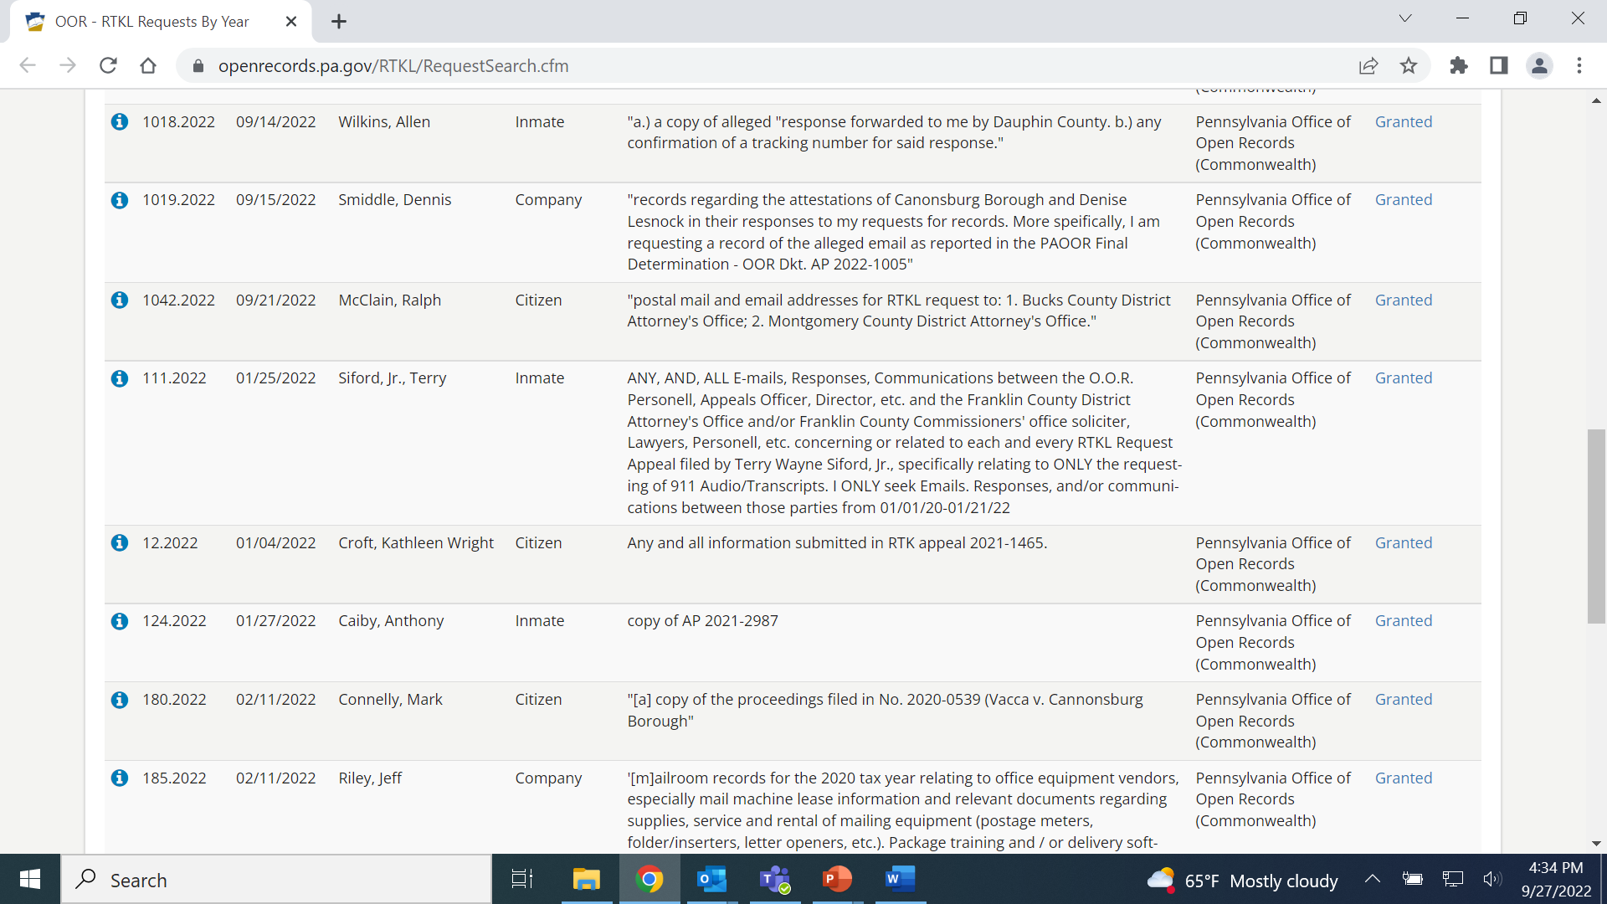
Post Records Online
Easy Access to Certain Records Helps Everyone
Post commonly-requested records online
Direct website users to appropriate agency for records your agency doesn’t possess
Post records granted via RTKL requests

Slide 22
Communicate with the Requester
Good communication can prevent and solve many issues
Requesters often submit broad requests to ensure they get all the records they want
Understandable, but can be expensive & frustrating
Requesters don’t want surprise bills
Agencies don’t want unnecessary work
Many requesters willing to discuss requests
Cannot require requester to provide reason for request
If agreement reached on revised request, put it in writing

Slide 23
Consider Granting Some Exempt Records
RTKL is not a confidentiality statute
None of the exemptions MUST be claimed
Again: Use common sense
Records can be released outside of the RTKL
An agency may exercise its discretion to make any otherwise exempt record accessible if:
Disclosure is not prohibited by law or regulation (ex. FERPA); and
The record is not protected by privilege; and
The agency head determines that public interest favoring access outweighs any interest favoring withholding.

Slide 24
Appoint the Right Employee as AORO
The Agency Open Records Officer (AORO) is VITAL
AORO receives RTKL training
AORO receives all requests & is point of contact for requesters
AORO contacts employees & contractors who may have records
AORO tracks deadlines for responses and appeals
AORO, when necessary, consults with agency head, solicitor
Alternate AORO is available when AORO is out of office
A resource account is used for RTKL requests and appeals

Slide 25
Conduct Agency Business on Agency Accounts/Devices
Records about agency business are subject to the RTKL, regardless of the “ownership” of the medium
Access to personal emails, personal Facebook messages, personal texts may be subject to RTKL if they discuss agency business.
Keep things simple by avoiding doing agency business on personal devices and accounts

Slide 26
Consider Mediation
Either party may request mediation as an alternative to the traditional “adversarial” appeals process.
If mediation is unsuccessful, the appeal is transferred to a different appeals officer for issuance of a final determination.
Particularly effective where the Request is broad or covers a large number of records that are responsive to the Request, but which the Requester may not have intended to seek.

Slide 27
Cite Lack of Specificity With Caution
Basing a Denial on Specificity Alone
Specificity is a complicated, subjective basis for denial
The OOR cannot rule on specificity first and then provide an opportunity to raise exemptions. All reasons for denial must be raised at the same time.
If no other reason for denial is provided by school district and the OOR disagrees with specificity argument, access to records will likely be granted.
May not be able to introduce new evidence or exemption in court appeal.

Slide 28
Requesting Records: Tips and Best Practices

Slide 29
Submit your RTKL Request to the Correct Agency
Submit requests to the agency that has the record
Rarely the OOR – we receive > 900 misdirected requests every year
Address requests to Agency Open Records Officer (AORO)
Commonwealth agencies each have own: DEP, DCNR, DOC, DCED, etc.
Some agencies have separate AOROs by bureau, dep’t, etc.
e.g., Philadelphia has approximately 40 AOROs
Important to send request to the right AORO
If not sure, say so: “If this request is misdirected, please let me know so I can withdraw it and direct it to the proper AORO.”

Slide 30
Be As Specific As Possible In Request
An agency can deny a request if it is deemed “insufficiently specific”
Request should attempt to identify a transaction/activity of an agency, and NOT ask for an overly-broad collection of records
“Emails Mary Smith sent about May 17, 2022 city council meeting” vs. “All emails Mary Smith ever sent in the last four years”
Attempt to address three areas:
Subject Matter: Identify ‘transaction or activity’ of the agency (e.g., “July 15 meeting about new park”)
Scope: Identify discrete group of docs (e.g., type or recipient)
Timeframe: Identify a finite period of time
This is the most fluid factor – failure to identify a finite timeframe will not automatically render a request overbroad & a short timeframe will not make an overbroad request specific
Timeframe can be implied (e.g., “the ongoing Pine Street repaving”)

Slide 31
Track and Dates & Deadlines In Case You Need to Appeal
Must state & local agency must respond in writing within 5 (agency) business days
If no response received, request is deemed denied
If an agency doesn’t respond at all within five days, onus is on requester to know to appeal within 15 business days; no remedy if you fail to do so.
Agency can extend timeline by 30 calendar days
Must be done in writing within the initial 5 business days
Any other extension must be agreed to by requester & in writing
Missing a deadline can curtail all of your efforts; no remedy if appeal is untimely.

Slide 32
Consider Engaging & Negotiating with Agency
May be willing to work with you on deadlines, better understand your request and thus reduce timeline and copying costs
Agencies cannot require you to disclose your motive in making the request, but they can ask questions in order to understand the specific records you are seeking

Slide 33
RTKL Does Not Apply to Police Recordings
Act 22 of 2017 covers police video & audio recordings
Must request recording within 60 days of its creation
Agency has 30 days to respond, may deny for various reasons
Denials may be appealed within 30 days to court; $125 fee
Law enforcement agencies & DAs have fairly broad discretion to release a recording (with or without a written request).
More info on OOR website

Slide 34
Other Request Tips
Anticipate exemptions; avoid walking into one by carefully crafting request so that it is not dismissed with obvious exemption
Seek records—don’t ask questions
Be cautious in asking for lists
Agency not required to create a list that doesn’t exist (unless a database pull)
Instead, ask for all responsive records will produce list that you are seeking
Consider submitting multiple requests at once
Might avoid getting all requests bogged down by one or two controversial ones
Also helpful if request is time sensitive
Learn about the database software used by the agency
If possible, learn capabilities of program/database – ask if unsure
Terminology can be important – use agency jargon if possible
Create, export, compile, format, CSV, TXT, comma-delimited…

Slide 35
Appealing a RTKL Denial: Tips and Best Practices

Slide 36
Multiple Reasons to Consider Appealing a RTKL Response
If agency denies access to some or all records requested
If agency redacts portions of granted records
If agency fails to respond to RTKL response by statutory deadline
Ask agency to redact nonpublic portions of record rather than deny access to entire record
If production of granted records is delayed by agency
Fee issues

Slide 37
Grant OOR Extensions Whenever Possible
Some appeals are complicated and require more extensive research; 30 days may not be sufficient
Heavy workload
This may allow the establishment of a briefing schedule, allowing agency to respond to requester’s arguments. A briefing schedule may also permit the requester to respond to the agency’s arguments.

Slide 38
Filing an Appeal is Simple and Free
Requester only required to submit basic info, but may choose to provide brief with legal arguments and point to specific evidence
Thousands of appeals are successfully appealed every year without the requester utilizing an attorney
An organized requester who keeps careful track of all dates and deadlines is all that is needed
If you have access to an attorney, can be helpful in more complicated situations or to reduce work for requester
Three simple requirements to appeal
Submit all required documents within 15 business days of agency denial/deemed denial
Fill out one-page appeals form; not required to provide legal basis for appeal
Provide all required documentation (listed on appeals form)

Slide 39
If you want to become involved in appeal…
Try to consider what would help the appeals officer
Refute each exemption raised by agency, ideally with specific court cases or previous OOR final determinations
Point to specific evidence to demonstrate an agency’s factual assertions may be incorrect
Submit an affidavit if trying to utilize factual information to demonstrate an agency may be wrong
If agency cites new or additional reasons for denial, ask for an opportunity to respond

Slide 40
Three Options After the OOR’s Final Determination
If you believe the OOR made an error, can request Petition for Reconsideration within 15 days of FD mailing
Cannot submit new evidence
OOR responds within 30 days
Agency or requester may appeal FD to court within 30 days of FD mailing; stays record request
Local agency → Court of Common Pleas
State agency → Commonwealth Court
Submit a new RTKL request that is modified based on why first attempt was denied
Different format, agency, or individuals named
More specific

Slide 41
Additional Questions?
Today’s training has been recorded and will be posted to our website.
If we did not answer your questions today or you have more questions, contact us:
Via website form: https://www.openrecords.pa.gov/ContactOOR.cfm,
Via email: openrecords@pa.gov, or
Via phone: 717-346-9903.
Submitted questions are records under the RTKL.
OOR website has resources for agencies & requesters
https://www.openrecords.pa.gov/

