Slide 1
OOR Annual Training November 7, 2019
Erik Arneson, Executive Director
https://openrecords.pa.gov
@ErikOpenRecords
@OpenRecordsPA
earneson@pa.gov
(717) 346-9903

Slide 2
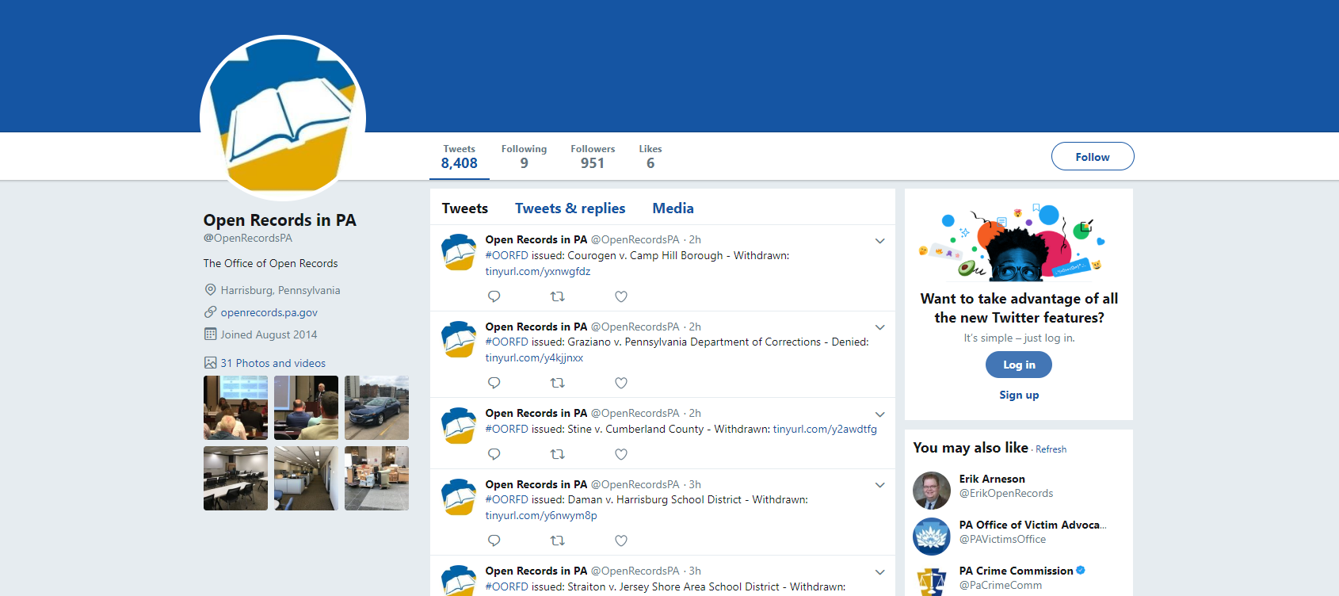
Introduction

Slide 3
Introduction
Submit questions for panel discussion at
openrecords@pa.gov

Slide 4
OOR Annual Training November 7, 2019
George Spiess, Training Coordinator
http://openrecords.pa.gov
gespiess@pa.gov
(717) 346-9903

Slide 5
Is It a Meeting?
Is there a quorum?
(members can “phone in”)
Is there deliberation?
Is there decision making?
Beware of email meetings and Social Media commenting!

Slide 6
What is Not a Meeting?
Work Sessions, Conferences, Retreats, etc…
Communication is one way (reports from staff)
There is no deliberation
There is no decision making

Slide 7
Who is Covered?
Applies to any state or local government body
and all committees
that perform an essential government function
and exercises authority to take official action
Making recommendations = official action

Slide 8
Public Notice
Three days in advance of the first regular meeting of the year, along with all of the remaining meetings
Legal notice in a paid newspaper of general circulation
-newspaper articles don’t count
-websites don’t count
-sales circulars don’t count
Posted at the meeting site

Slide 9
Public Notice continued
Special Meetings (not previously scheduled) = 24 hours advance notice
Emergency Meetings = no notification required, but you can’t “create” your emergency
No notification requirement for cancellations

Slide 10
Public Comment
Commenters can be limited to residents and taxpayers
Right to comment on issues that are or may be before the board (before any pertinent votes)
Board may establish reasonable rules for public comment (time limits, spokespersons, specific v. general)

Slide 11
Executive Sessions
Can be held before, during, or after an open meeting, or announced for some future time
Complete reason must be announced during the open meeting (Reading v. Reading Eagle)
No requirement for minutes
No official action can be taken during an Executive Session – votes must occur in a public session

Slide 12
Executive Sessions II
Allowable Reasons for Executive Sessions:
Personnel matters (hiring, firing, discipline)
Discussing labor negotiations
Considering purchasing, leasing or selling property
Consulting with counsel about litigation
Avoiding violating privilege or confidentiality
Discussing university admission standards
Discuss emergency preparedness

Slide 13
Violations
The public can object to a perceived violation at any time during the meeting
Agencies can “cure” violations
Complaints = public has 30 days to go to court to seek legal relief, or to a District Attorney to investigate alleged criminal intent
Meetings can be voided
Fines are paid by the officials, not the agency

Slide 14
Miscellaneous
Must produce meeting minutes recording board attendance and who voted for and against
No requirement for an agenda
Public can record public meetings unannounced
Agency recordings and minutes are public records

Slide 15
OOR Annual Training November 7, 2019
Charles Rees Brown, Chief Counsel
http://openrecords.pa.gov
charlebrow@pa.gov
(717) 346-9903

Slide 16
Agencies
Section 102, 65 P.S. § 67.102 (defines agencies)
Pysher v. Clinton Twp. Vol. Fire Co., 209 A.3d 1116 (Pa. Commw. Ct. 2019)
WNEP-TV v. Clinton Twp. Vol. Fire Co., 212 A.3d 145 (Pa. Commw. Ct. 2019) (unreported)

Slide 17
Contractor records
Section 506(d)(1), 65 P.S. § 67.506(d)(1) (records in the possession of contractors)
Equity Forward v. Pa. Dep’t of Human Servs., No. 225 C.D. 2018 (Pa. Commw. Ct. 2019) (unreported)

Slide 18
Coroner’s records
Section 708(b)(20), 65 P.S. § 67.708(b)(20) (coroner records)
Coroner’s Act, 16 P.S. § 1201-B et seq.
Walker v. County of Lancaster, No. CI-18-09547 (Lancaster C.C.P. Aug. 23, 2019)

Slide 19
Donation records
Section 708(b)(13), 65 P.S. § 67.708(b)(13) (donation records)
California Univ. of Pa. v. Bradshaw, 210 A.3d 1134 (Pa. Commw. Ct. 2019)

Slide 20
Educational records
Federal Educational Rights and Privacy Act (“FERPA”), 20 U.S.C. § 1232g
West Chester Univ. of Pa. v. Rodriguez, No. 1078 C.D. 2018 (Pa. Commw. Ct. 2019) (unreported)

Slide 21
Internal, predecisional deliberative records
Section 708(b)(10)(i)(A), 65 P.S. § 67.708(b)(10(i)(A)
Finnerty v. Pa. Dep’t of Comm. & Econ. Dev., 208 A.3d 178 (Pa. Commw. Ct. 2019)
Finnerty v. Pa. Dep’t of Comm. & Econ. Dev., 208 A.3d 219 (Pa. Commw. Ct. 2019) (unreported)

Slide 22
Judicial records
Section 102, 65 P.S. § 67.102 (defines judicial agencies)
Section 304, 65 P.S. § 67.304 (obligations of judicial agencies)
Section 503(b), 65 P.S. § 67.503(b) (judicial appeals officers)
Phila. Dist. Attorney’s Office v. Williams, 204 A.3d 1062 (Pa. Commw. Ct. 2019)

Slide 23
Fees & Penalties
Section 1304, 65 P.S. § 67.1304 (court costs and attorney fees)
Section 1304, 65 P.S. § 67.1305 (civil penalties)
The Scranton Times-Tribune v. City of Scranton, No. 2019-CV-3668 (Lackawanna C.C.P. Aug. 13, 2019)
Warren v. State Ethics Comm’n, 199 A.3d 521 (Pa. Commw. Ct. 2018)

Slide 24
Right to Privacy
Pa. Constitution, Article 1, § 1
Governor’s Office of Admin. v. Campbell, 202 A.3d 890 (Pa. Commw. Ct. 2019)
Pa. Liquor Control Bd. v. Beh, Nos. 91, 153 C.D. 2018 (Pa. Commw. Ct. 2019)

Slide 25
Procedural Matters
Crocco v. Pa. Dep’t of Health, 214 A.3d 316 (Pa. Commw. Ct. 2019) (waiver)
Mission Pa. v. McKelvey, 212 A.3d 119 (Pa. Commw. Ct. 2019) (supplementing the evidentiary record/staying OOR appeal)
County of Berks v. Office of Open Records, 204 A.3d 534 (Pa. Commw. Ct. 2019) (in camera review of records)

Slide 26
Procedural Matters cont.
Vu v. Pa. Bd. of Prob. & Parole, 200 A.3d 627 (Pa. Commw. Ct. 2018) (extending the time to issue a final determination)
Brown v. Pa. Dep’t of Health, 201 A.3d 312 (Pa. Commw. Ct. 2018) (unreported) (actual receipt of records)

Slide 27
Cases to look out for next year…
Uniontown Newspapers, Inc. v. Pa. Dep’t of Corr., 76 MAP 2019 (Pa.) (fees & penalties)
Easton Area Sch. Dist. v. Miller, 13 MAP 2019 (Pa.) (FERPA/bus video)
Central Dauphin Sch. Dist. v. Fox43 News, 16 MAL 2019 (Pa.) (FERPA/bus video)
Pa. State Police v. ACLU, 66 MAP 2018 (Pa.) (in camera review)

Slide 28
Cases con’t
Pa. Liquor Control Bd. v. Burns, No. 1159 C.D. 2019 (Pa. Commw. Ct.) (liquor licenses)
Lehighton Area Sch. Dist. v. Campbell, No. 2019-0421 (Carbon C.C.P.) (procedural due process)
County of Adams v. Office of Open Records, et al., No. 2019-SU-907 (Adams C.C.P.) (procedural due process)

Slide 29
OOR Annual Training November 7, 2019
Delene Lantz, General Counsel
http://openrecords.pa.gov
Nbyerly@pa.gov; Dlantz-Joh@pa.gov
(717) 346-9903

Slide 30
OOR Regulations
Updated draft regs on website
Proposed Rulemaking Steps
Internal process
Attorney General/Office of Budget
Legislative Committees/Legislative Reference Bureau/ Internal Regulatory Review Commission
Public Comment period

Slide 31
OOR Appeal Portal
The OOR Appeal portal is an online docketing records management system designed to streamline and automate the appeals process. Appeals filed and all submissions to the OOR are accessible in real time and allow the requestor, the agency and the Appeals Officers to file, receive and have access to documents and submissions.

Slide 32
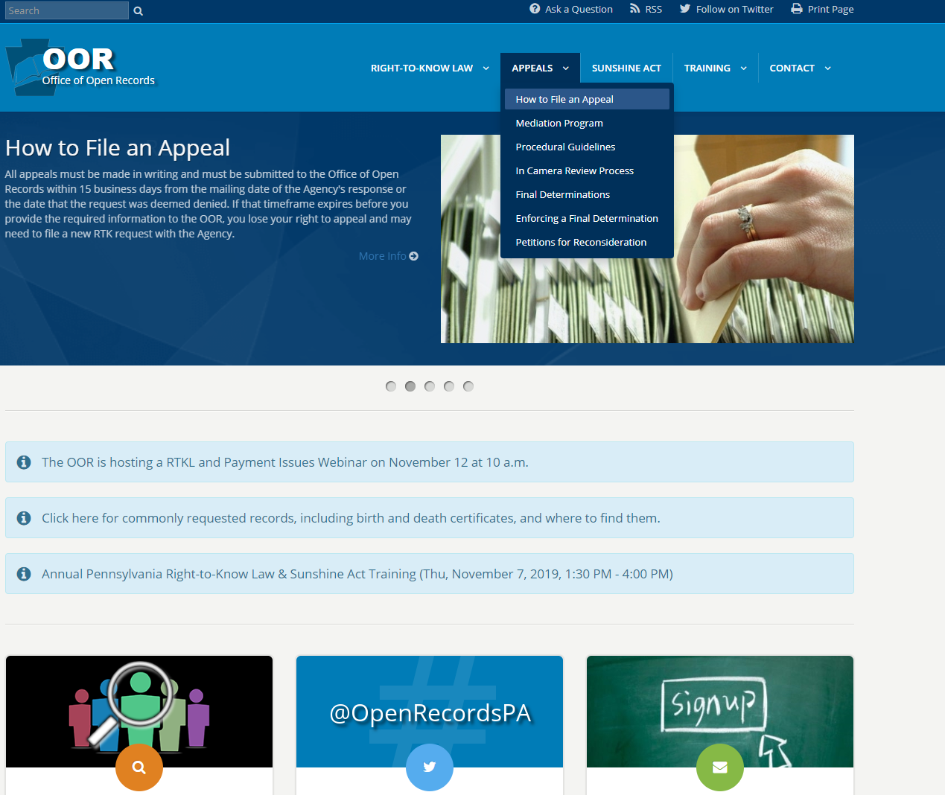
Filing a new appeal

Slide 33
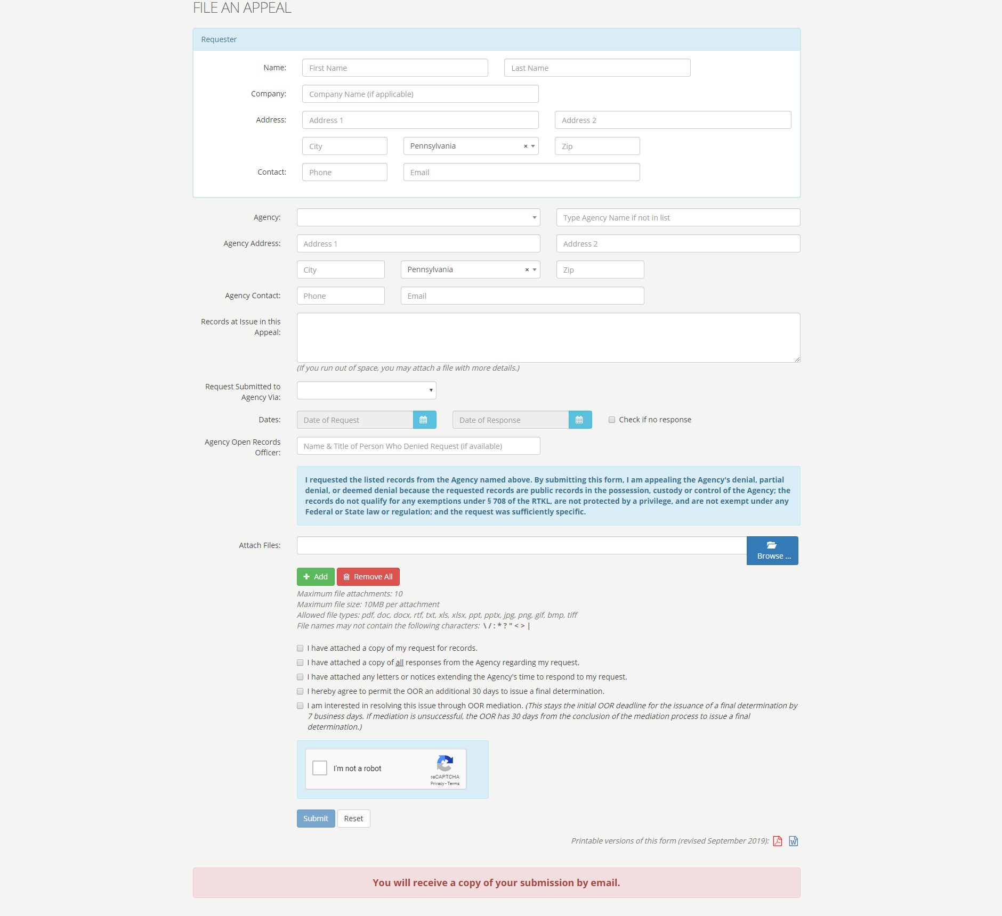

Slide 34
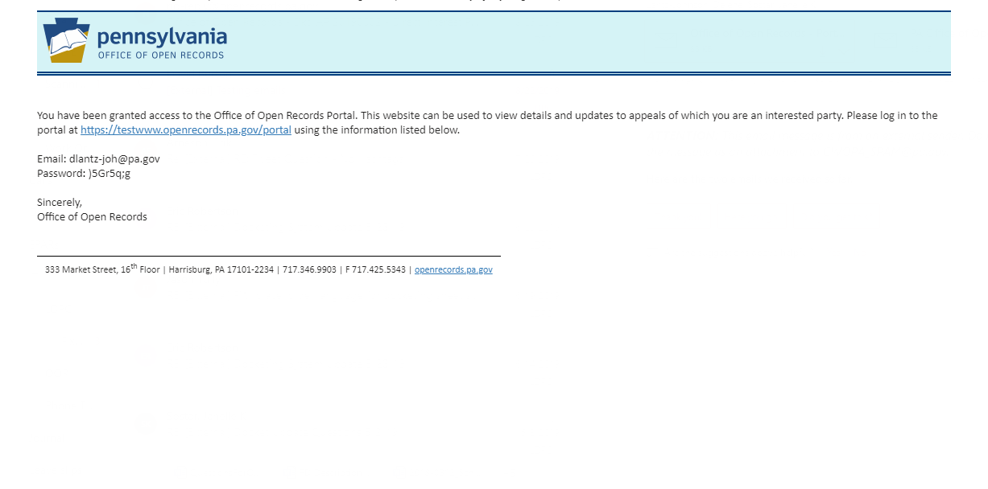
Portal access granted

Slide 35
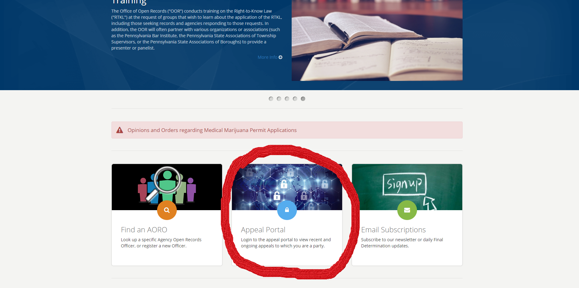
How to access portal

Slide 36
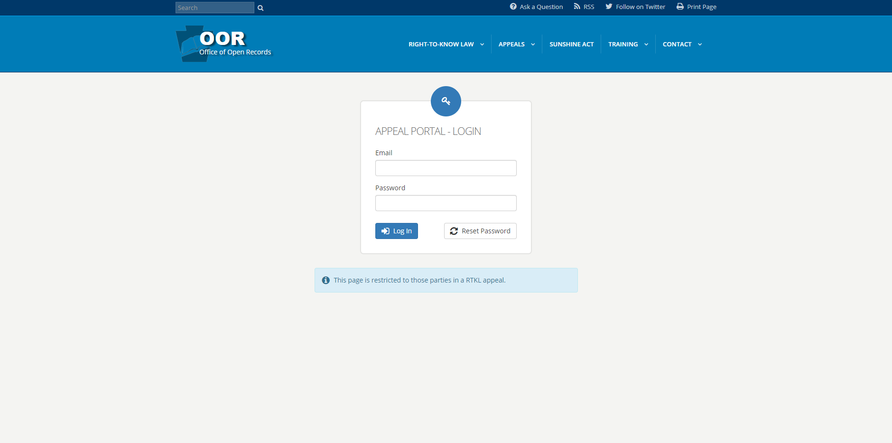
Portal login

Slide 37
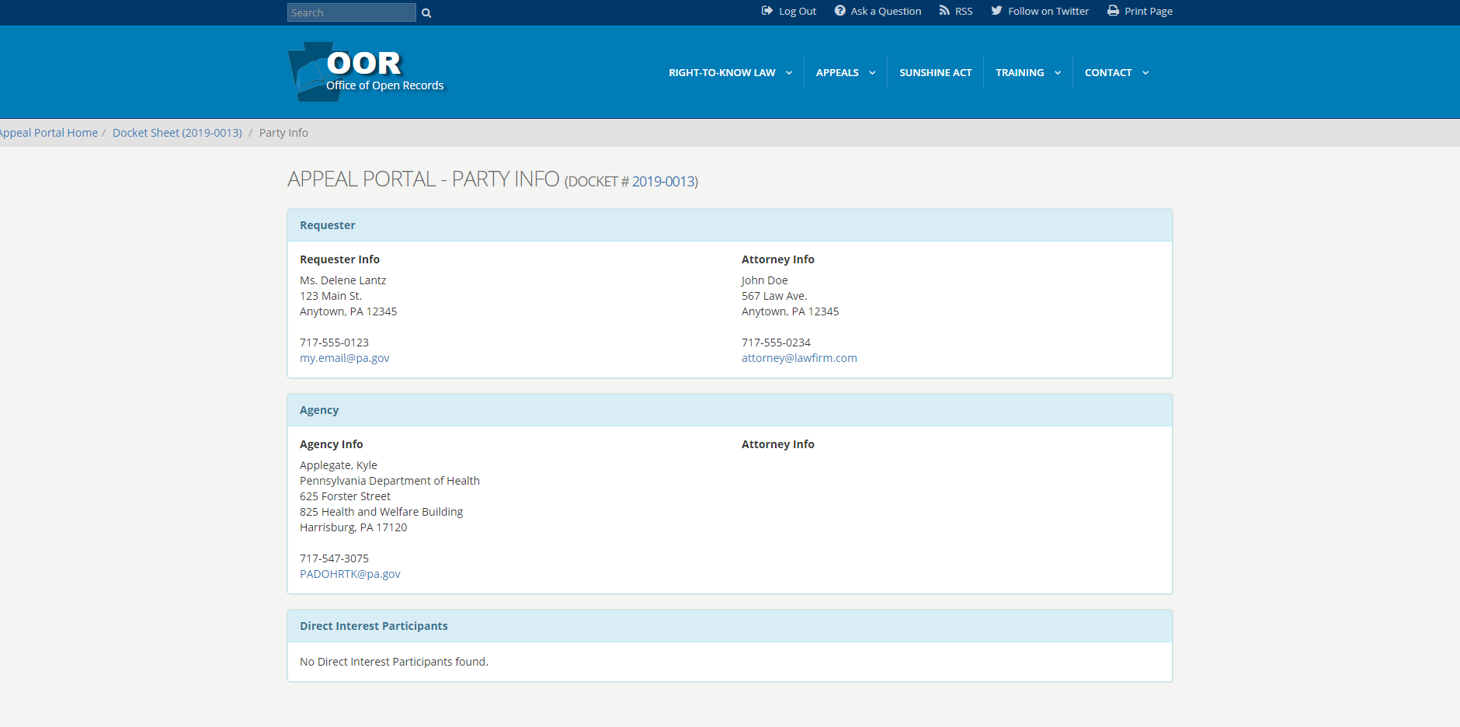
Party Information

Slide 38
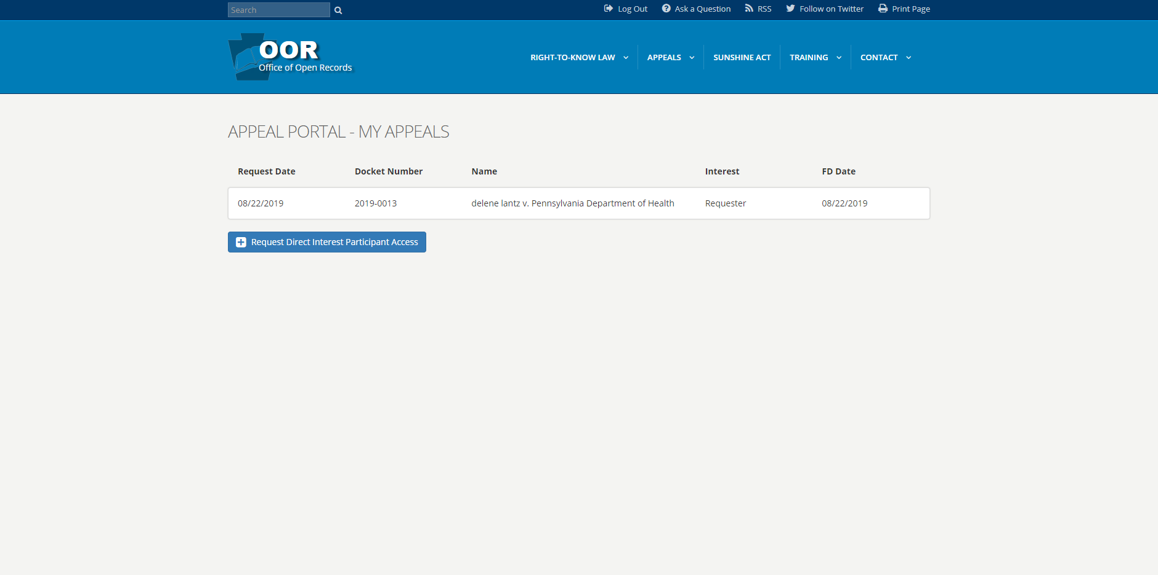
List of appeals

Slide 39
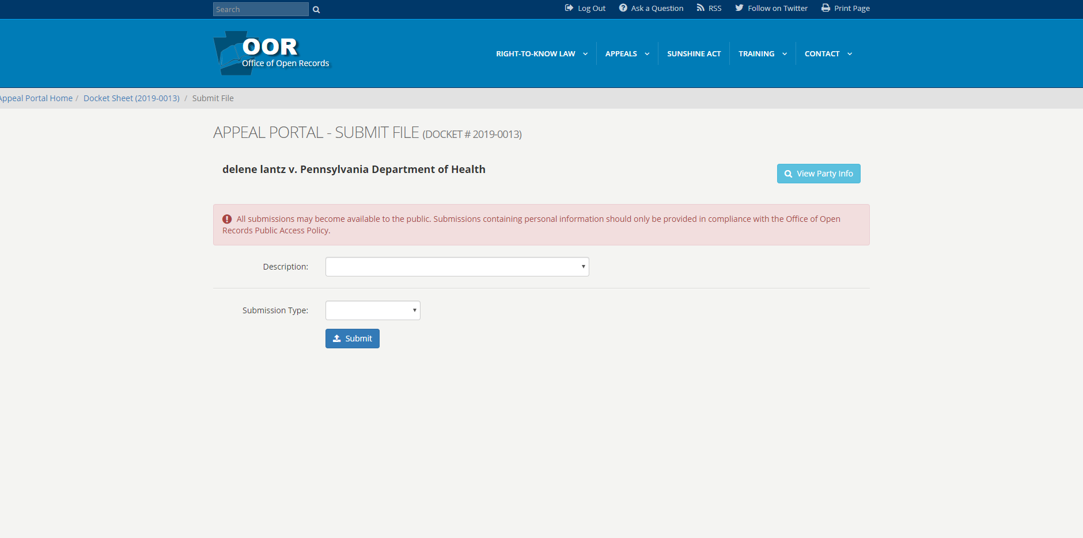
Submitting files

Slide 40
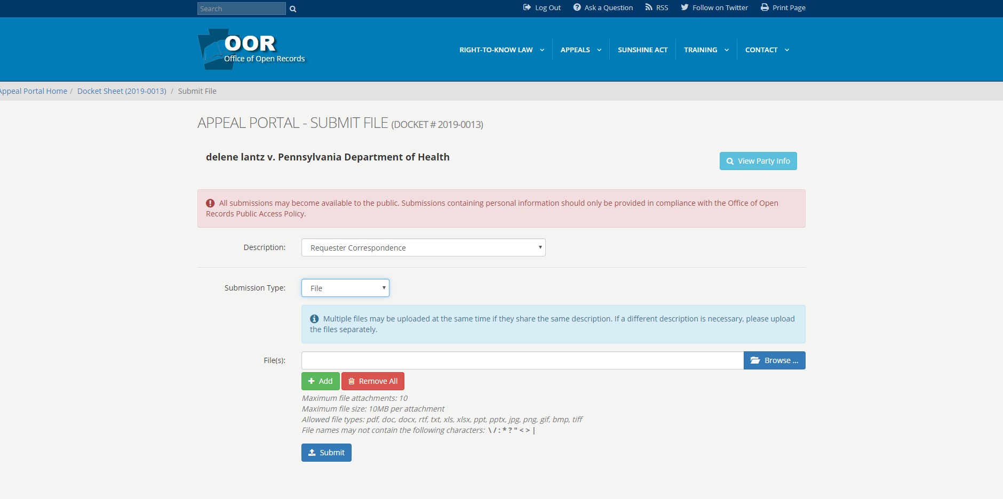
Submitting files

Slide 41
New file notification

Slide 42
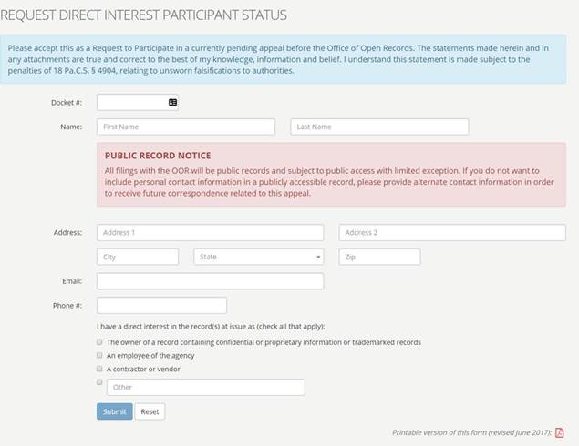
Adding a Direct Interest Participant

Slide 43
Direct Interest Participant notification

Slide 44
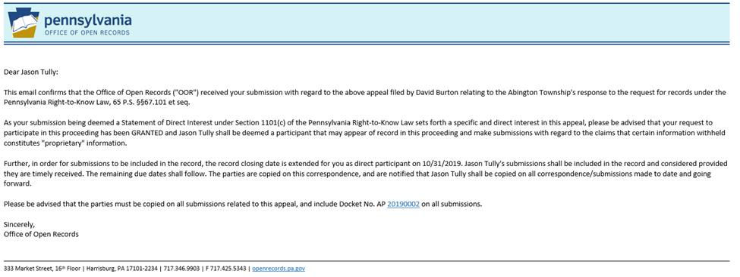
Direct Interest Participant

Slide 45
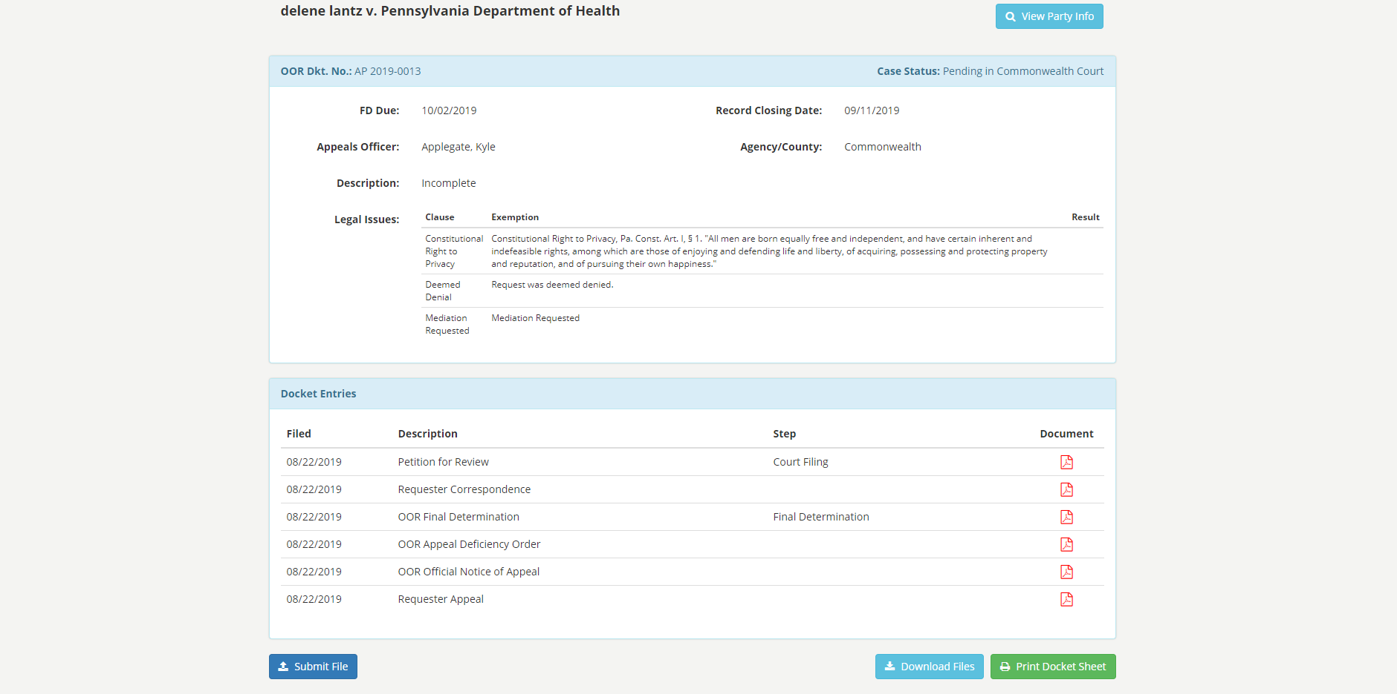
Docket Sheet

Slide 46
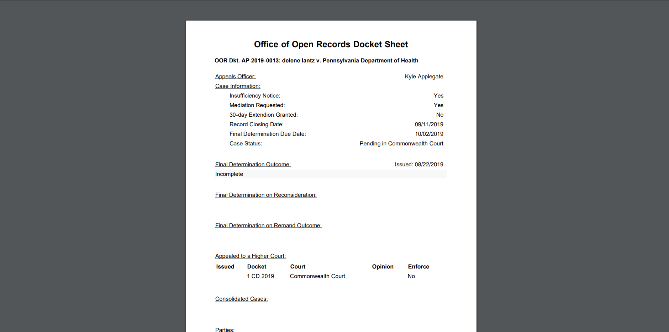
Docket Sheet pdf

Slide 47
Questions
Submit questions for panel discussion at
openrecords@pa.gov

