Slide 1
The Office of Open Records webinar will begin soon
Use the “Conversation” box to submit questions
Submitted questions are records under the RTKL
After the webinar ends:
Email openrecords@pa.gov or call 717-346-9903
OOR website has resources for agencies & requesters
https://www.openrecords.pa.gov/

Slide 2
2018 Office of Open Records Annual Report March 15, 2019
Erik Arneson, Executive Director
https://openrecords.pa.gov
@ErikOpenRecords
@OpenRecordsPA
earneson@pa.gov
(717) 346-9903

Slide 3
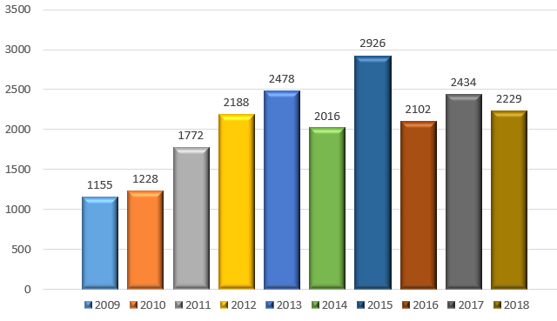
Appels Filed by Year

Slide 4
Appels Filed by Year
Number of appeals filed relatively steady since 2012
Between 2,000 and 2,500 appeals in 6 of past 7 years
Exception: 2,926 appeals in 2015
Three-year average: 2,255
Five-year average: 2,341

Slide 5
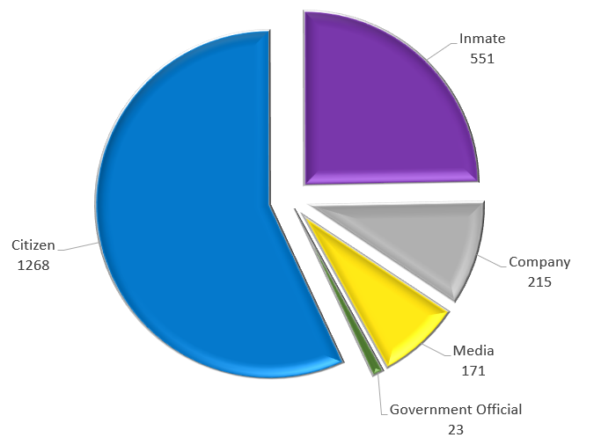
Who Filed Appeals in 2018?
Appellants fall into five categories
Everyday citizens, 56.9%
Inmates, 24.7%
Companies, 9.6%
Media, 7.7%
Government officials, 1.0%

Slide 6
Requests vs. Appeals – 2018
Comparing AORO survey data to OOR appeal data
Inmates: 1.5% of requests
Inmates: 24.7% of appeals
Commercial requesters: 30.2% of requests
Companies: 9.6% of appeals
News media: 3.8% of requests
Media: 7.7% of appeals

Slide 7
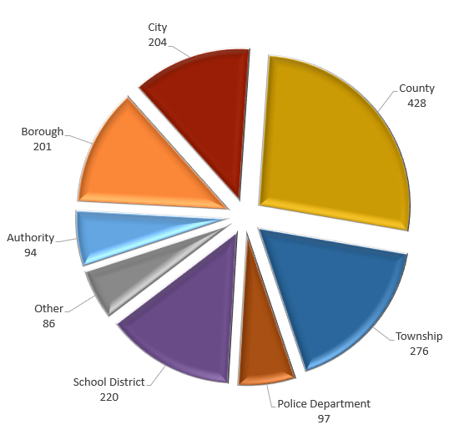
Appeals Involving Local Agencies in 2018
1,606 appeals involved local agencies
Municipalities (cities, boroughs & townships), 42.4%
Counties, 26.7%
School districts, 13.7%
Police departments, 6.0%
Authorities, 5.9%
Other, 5.4%

Slide 8
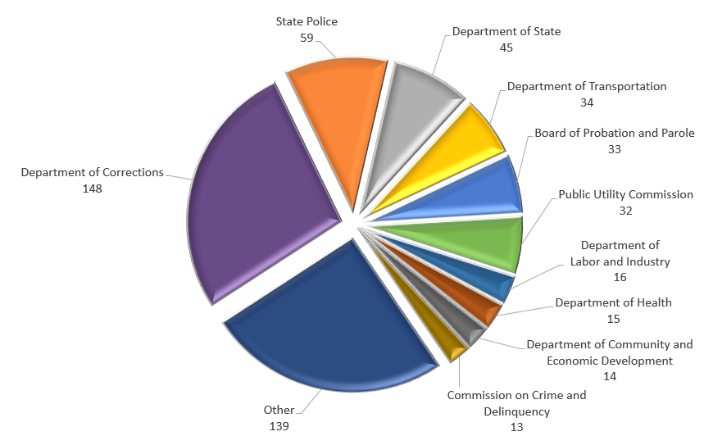
Appeals Involving State Agencies in 2018
559 appeals involved state agencies
Corrections, 27.0%
State Police, 10.8%
Dept. of State, 8.2%
PennDOT, 6.2%
Probation & Parole, 6.0%
Other, 41.8%

Slide 9
Issues Raised by Agencies on Appeal
2018 was the second year the OOR tracked this data
(b)(17) Noncriminal investigation, 96 cases
(b)(16) Criminal investigation, 83
(b)(10) Internal, predecisional deliberations, 53
(b)(6) Personal identification information, 49
(b)(2) Public safety, 33

Slide 10
Issues Raised by Agencies on Appeal
Issues not related to the Section 708(b) exemptions
Records do not exist, 339
Not in agency possession or not records of agency, 180
Request not specific or request asked questions, 102
Attorney-client privilege, 49

Slide 11
Training & Mediations
We traveled the state in 2018
63 Training Sessions
Locations included Erie, Freedom, Indiana, Morrisville, Pittsburgh, Radnor, Upper Macungie & Sunbury
Colleges and universities, including Gannon, Lock Haven, Penn State & my alma mater Temple
68 Mediations
Most conducted via phone, email and/or Skype, but we do go on location when necessary

Slide 12
Records Accessed via the RTKL in 2018
Financial Records
More than $1 million paid to constables by magisterial district courts in Reading, far more than any other municipality.
$320,970 paid by Philadelphia City Council for a fleet of 13 new SUVs, plus an additional $46,000 in gasoline and maintenance.
The cost of ransomware attacks on agency computers, including paid ransoms and rebuilding infected systems.

Slide 13
Records Accessed via the RTKL in 2018
Other records
Data showing a significant decline in racial diversity among teachers in Philadelphia School District.
28 reports of bed bugs in a university’s dormitories over six years, with 12 of those reports being confirmed.
Inspection report identifying issues with overhead conduits in a Turnpike tunnel where a driver was killed.

Slide 14
The Amazing OOR Staff
Dedicated, talented and hard-working
Administrative Team: Dylan Devenyi, Faith Henry, Michele Kusery-Grant & Janelle Sostar
Appeals Officers: Kyle Applegate, Joy Baxter, Erin Burlew, Jordan Davis, Angie Edris, Blake Eilers, Kelly Isenberg, Ryan Liggitt, Jill Wolfe, Joshua Young & Magdalene Zeppos
Chief of Training & Outreach: George Spiess
Executive Team: Charles Rees Brown, Nathan Byerly & Delene Lantz

Slide 15
OOR Resources
Website, Twitter, Email Lists & More
Web: https://openrecords.pa.gov/
Blog: https://openrecordspennsylvania.com/
Email lists: Daily Digest of FDs & General Updates
https://www.openrecords.pa.gov/EmailSubscriptions.cfm
Twitter: @OpenRecordsPA
Executive Director: @ErikOpenRecords
YouTube Channel
Open Records in PA Podcast: Apple Podcasts, Stitcher, etc.

Slide 16
Webinar Q&A
Please send your questions now
Use the “Conversation” box to submit questions
Submitted questions are records under the RTKL
After the webinar ends:
Email openrecords@pa.gov or call 717-346-9903
OOR website has resources for agencies & requesters
https://www.openrecords.pa.gov/

