Slide 1
The Right-to-Know Law for Requesters August 26, 2020
Erik Arneson, Executive Director
https://openrecords.pa.gov
@ErikOpenRecords
@OpenRecordsPA
earneson@pa.gov
(717) 346-9903

Slide 2
Right-to-Know Law Basics
The basic RTKL process:
Requester submits request to state or local agency
Request must seek records, not ask questions
Agency responds: grant, deny, or mix of both
If request is denied (even in part), requester can appeal to OOR
OOR issues a binding final determination
Either side can appeal to court (happens <10% of the time)
Court of Common Pleas for local agencies
Commonwealth Court for state agencies

Slide 3
What is a Record?
A record is…
“information, regardless of physical form or characteristics, that documents a transaction or activity of an agency and that is created, received or retained pursuant to law or in connection with a transaction, business or activity of the agency” – Section 102 of Right-to-Know Law
PA Office of Attorney General v. Philadelphia Inquirer (No. 2096 C.D. 2014, decided Nov. 19, 2015)

Slide 4
Records Take Many Shapes
The Right-to-Know Law…
Doesn’t distinguish between formats
Paper, email, texts, social media, audio, video, etc.
Doesn’t distinguish between agency & personal devices
Or between agency & personal email accounts
Or between agency & personal social media accounts
All that matters: Is it a record? And if so, is it a public record?

Slide 5
Right-to-Know Law Basics
All state & local government records presumed to be public
30 exceptions in RTKL allow records to be withheld
Fewer apply to financial records & aggregated data
Other laws & regulations (e.g., HIPAA, FERPA)
Attorney-client privilege & other privileges
Only if recognized by PA courts; not “self-critical evaluation”
Records can be made non-public by court order
When a denial is appealed, agency bears burden of proof

Slide 6
How to File a RTK Request
Submit your RTK request to the correct agency
Submit requests to the agency that has the record
Rarely the OOR – we receive >900 misdirected requests every year
Address requests to Agency Open Records Officer (AORO)
AORO database available on OOR website

Slide 7
More About Agency AOROs
Many agencies, but not all, have a single AORO
Commonwealth agencies: DEP, DCNR, DOC, DCED, etc.
Some agencies have separate AOROs by bureau, dep’t, etc.
e.g., Philadelphia has approximately 40 AOROs
Important to send request to the right AORO
If you’re not sure, say so: “If this request is misdirected, please let me know so I can withdraw it and direct it to the proper AORO.”

Slide 8
How to File a RTK Request
Some basic steps:
Remember: The RTKL is not a weapon!
Use the appropriate form to request records
Agencies must accept the OOR’s Standard RTK Request Form
If agency has its own form, strongly consider using that one
Be specific when describing records: subject matter, date(s), type of record, sender and/or recipient, etc.
Always note the request date to track timing of response!

Slide 9
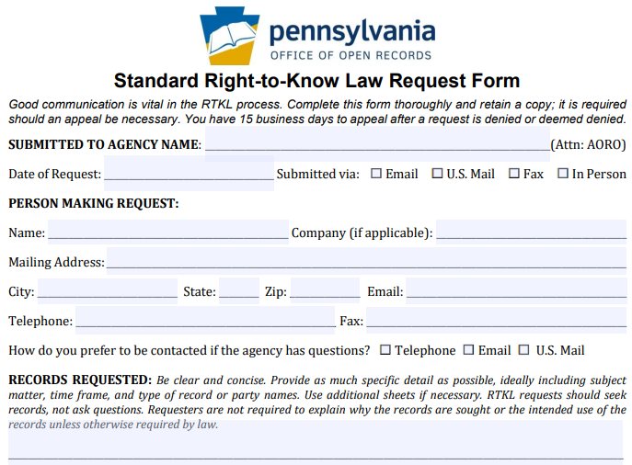
How to File a RTKL Request
OOR Standard RTK Request Form, part 1

Slide 10
How to File a RTKL Request
OOR Standard RTK Request Form, part 1

Slide 11
How to File a RTKL Request
OOR Standard RTK Request Form, part 1

Slide 12
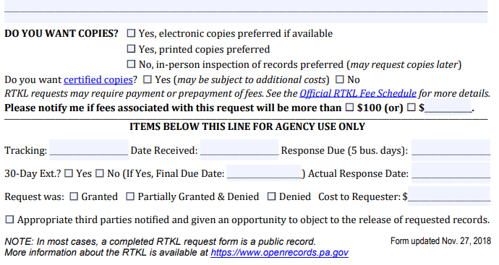
How to File a RTKL Request
OOR Standard RTK Request Form, part 2

Slide 13
How to File a RTKL Request
OOR Standard RTK Request Form, part 2

Slide 14
How to File a RTKL Request
OOR Standard RTK Request Form, part 2

Slide 15
Timeline of a RTKL Response
Every state & local agency must respond to RTK requests
Must respond in writing within 5 (agency) business days
If no response received, request is deemed denied
Allow additional 3 business days for postal mail before filing appeal
Agency can extend timeline by 30 calendar days
Must be done in writing within the initial 5 business days
Any other extension must be agreed to by requester & in writing
Track all dates & deadlines in case you need to appeal

Slide 16
Tracking Dates: An Example
Oscar Olsen v. Local Agency
Aug. 1, 2019 – request made (on a Thursday)
Aug. 8, 2019 – agency took 30-day extension (to Sept. 7)
Sept. 7 is a Saturday, so deadline moves to Monday, Sept. 9
Sept. 12, 2019 – agency emails, asks for 30 more days
Requester emails back, says that’s fine
Oct. 1, 2019 – agency issued response (denied in part)
Oct. 1, 2019 – requester filed appeal with OOR
Request was deemed denied on Sept. 9; appeal was due on Sept. 30
OOR has no choice but to dismiss appeal as untimely

Slide 17
Agency Response: Costs & Format
OOR fee schedule developed pursuant to RTKL
No charge for electronic records
Redactions may necessitate printing electronic records
Up to $0.25/page for hard copies (8.5 x 11)
Requesters can photograph records they asked to inspect
Agencies do not have to create a record
Agencies required to provide records in medium requested (electronic vs. hard copy)

Slide 18
Agency Response: Denials
If an agency denies a request, it is required by the RTKL to:
Provide the denial in writing
Explain what records are being withheld
Explain why records are being withheld
Explain how to appeal the denial
Failure to respond by the statutory deadline is a “deemed denial” & can be appealed

Slide 19
Writing a Good RTK Request: 1. Seek Records, Don’t Ask Questions
Requests should seek records, not ask questions
RTKL gives access to public records – not a venue for questions
Why did the Chairman vote yes?
Request meeting minutes & audio recording of meeting
Why did Company X get this contract?
Request copies of all submitted bids & council emails re: Company X
Agencies may deny requests which ask questions

Slide 20
Writing a Good RTK Request: 2. Be Specific
Specificity is determined on a case-by-case basis
Primary goal is to enable agency to know what to look for
Vast “fishing expeditions” not permitted
Phrases like “any and all” & “but not limited to” raise questions
“Any and all records, including but not limited to emails, memos, and spreadsheets, about the 2019 Pine Street Bridge Project”
“Records relating to the 2019 Pine Street Bridge Project”

Slide 21
Writing a Good RTK Request: 2. Be Specific
Example: A good request
Upper Smith Twp. replaced the Pine Street bridge in Oct. 2019. I’m seeking the following records about that project:
Emails from 7/1/2019 to 10/31/2019
(NOTE: Whenever possible, list senders & recipients on any email request)
Memos from 3/1/2019 to 10/31/2019
Invoices from 1/1/2019 to 12/31/2019
Records of Disbursements from 1/1/2019 to 12/31/2019
Please contact me with any questions about this request.

Slide 22
More About Specificity
Specificity is a 3-part test: Pa. Dep’t of Educ. v. Post-Gazette
Subject Matter: Identify ‘transaction or activity’ of the agency
Scope: Identify discrete group of docs (e.g., type or recipient)
Timeframe: Identify a finite period of time
This is the most fluid factor – failure to identify a finite timeframe will not automatically render a request overbroad & a short timeframe will not make an overbroad request specific
Timeframe can be implied (e.g., “the ongoing Main Street repaving”)

Slide 23
Specificity: Examples
Commonwealth Court cases on specificity:
Pa. Dep’t of Educ. v. Pittsburgh Post-Gazette: A request seeking all of the emails of the Acting Secretary of Education “as they pertain to the performance of her duties as Acting Secretary since she was appointed on Aug. 25, 2013 to date [Aug. 5, 2014]” was found to be insufficiently specific because “it is, by virtue of the Secretary’s position, a request for emails about all of the agency’s activity overly nearly a one year period. In other words, it is a fishing expedition”

Slide 24
Specificity: Examples
Commonwealth Court cases on specificity:
Dep’t of Envtl. Prot. v. Legere: A request for 4 years of Section 208 determination letters was sufficiently specific despite the scope of the request because the subject matter was extremely specific
How records are organized is not held against requester
Dep’t of Corr. v. St. Hilaire: A request for “all records” documenting inmate injuries or death for five years was sufficiently specific because the request had clear parameters even though a large number of records were implicated

Slide 25
Specificity: Keywords
Beware of using only keywords!
Office of the Governor v. Engelkemier: Request for all emails from Chief of Staff Katie McGinty from January 2015 to July 2015, with keywords, was sufficiently specific – but note discussion about Office waiving specificity argument earlier in the process and potential for “broad” keywords to be insufficiently specific
Be careful when using keywords!
Request must still identify a transaction or activity of the agency

Slide 26
Specificity: Keywords
When keywords go wrong
Emails from Erik Arneson containing the keyword “Arneson”
Emails & texts containing “concern,” “concerned,” “concerning,” “complaint,” “complained,” “complaining”
Emails containing “the,” “it,” “is,” “and”
Bottom Line: Keywords can be helpful, but relying on keywords alone is risky (e.g., Add this at the end of a request: “One way to satisfy my request would be to search Jane Smith’s emails for the keywords ‘John Doe’ and ‘suspension’”)

Slide 27
Writing a Good RTK Request: 3. Think Twice Before Requesting a List
Requesting a “list” can be problematic
If no actual list exists, agency not required to create one
“List of all lawsuits filed against the agency in 2017”
“List of all properties with zoning violations, 2015 to present”
Better to seek records containing the information you want
“Records showing captions of lawsuits filed against agency in 2017”
“Records showing zoning violations issued, 2015 to present”
Valid to add: “If info can be provided in a list, please do”

Slide 28
Writing a Good RTK Request: 4. Accessing Information in Databases
Information in databases subject to presumption of openness
Learn about the database software used by the agency
If possible, learn capabilities of program/database – ask if unsure
How do agency employees extract info from database
Terminology can be important – use agency jargon if possible
Create, export, compile, format, CSV, TXT, comma-delimited…

Slide 29
Writing a Good RTK Request: 4. Accessing Information in Databases
Suggesting queries can be helpful
Where relevant, consider suggesting specific queries
Queries may be necessary for extracting information
Suggested queries can help focus agency searches
But always identify the transaction or activity of the agency
Relying only on suggested queries can be risky & lead to a denial
Remember: RTKL requires specificity in requests & first step is identifying a transaction or activity

Slide 30
Databases: Commonwealth Court
Gingrich v. Pennsylvania Game Commission (2012)
Records related to deer harvest & habitat
“Requesters may provide suggestions or examples in order to better inform an agency about the information requested, and we have no desire to discourage that practice.”
“Providing data from an agency database does not constitute creating a record. … [I]nformation contained in a database must be accessible to requesters and provided in a format available to the agency.”

Slide 31
Databases: Commonwealth Court
Department of Environmental Protection v. Cole (2012)
Records related to rebates for solar energy projects
Commonwealth Court: “[A]n agency can be required to draw information from a database, although the information must be drawn in formats available to the agency. In short, to the extent requested information exists in a database, it must be provided … To hold otherwise would encourage an agency to avoid disclosing public records by putting information into electronic databases.”

Slide 32
Databases: Additional Cases
Intersection of RTKL & databases still being developed
Agency may be made to prove query was properly structured
OOR 2017-1761: Violent crime data from Pittsburgh
Don’t be overly specific & hurt your request
OOR 2016-2041: Sought TXT or CSV, records only available in PDF
Law currently only specifies electronic vs. hard copy
OOR 2017-0426: Sought “comma- or tab-delimited,” provided in PDF
OOR 2016-1591: When available in native PDF, records must be provided in that format as opposed to scanned PDF

Slide 33
Speaking of Databases…
Two useful resources:
Online Contract Database, http://contracts.patreasury.gov/
State agency contracts of $5,000 or more
PennWATCH, http://pennwatch.pa.gov/
State employee names, titles, salaries & compensation
State agency employee counts
Basic state budget data

Slide 34
Common Exemptions Raised by Agencies
Exemptions raised most often during appeals to OOR in 2018
Noncriminal investigative, 708(b)(17)
Criminal investigative, 708(b)(16)
Personal identification information, 708(b)(6)
Internal, predecisional deliberations, 708(b)(10)
Certain agency employee information, 708(b)(7)
Personal security, 708(b)(1)
Public safety, 708(b)(2)

Slide 35
Noncriminal Investigative Exemption
Section 708(b)(17) allows agencies to withhold:
Investigative materials, notes, correspondence & reports
Identity of a confidential source
Work papers underlying an audit
Records that would reveal the institution, progress or result of an investigation, except:
Imposition of a fine or civil penalty
Suspension, modification or revocation of a license, permit, etc.
Executed settlement agreement (unless made confidential by a court)

Slide 36
Criminal Investigative Exemption
Section 708(b)(16) allows agencies to withhold:
Investigative materials, notes, correspondence, videos & reports
Identity of a confidential source
Victim information
Records that would:
Reveal the institution, progress or result of a criminal investigation except the filing of criminal charges;
Impair the ability to locate a defendant; or
Hinder an arrest, prosecution or conviction

Slide 37
Criminal Investigative Exemption
Section 708(b)(16) does NOT allow agencies to withhold:
Private criminal complaints – these are public
Typically obtained from the county district attorney
Police blotters – these are public
If you want police blotter information, use the term “police blotter”
Definition is in 18 Pa.C.S. § 9102: A “chronological listing of arrests, usually documented contemporaneous with the incident, which may include, but is not limited to, the name and address of the individual charged and the alleged offenses”

Slide 38
Police Policies & Training Records
Policies & training records are often public, at least in part
Police department policies
Including department-wide training requirements
Some policies may be redacted
Individual officer training records may be available
Bucks County Courier Times (April 19, 2019): “A veteran New Hope police officer who shot and wounded a Pipersville man after confusing his stun gun with his Glock 22, had not been re-certified in the use of his police-issued Taser since at least 2016, according to a review of records obtained by this news organization.”

Slide 39
Appealing Denials From a Local Law Enforcement Agency
Certain appeals go to the local District Attorney:
Section 503(d)(2): “The district attorney of a county shall designate one or more appeals officers to hear appeals … relating to access to criminal investigative records … of a local agency of that county”
This alternative appeal process only applies to denials based on 708(b)(16).
However: OOR always transfers such cases to the DA.
Appealing to OOR never hurts; sometimes OOR & DA have joint jurisdiction.
OOR hears all cases involving Pennsylvania State Police

Slide 40
Requesting Police Recordings
RTKL does not apply to police recordings
Act 22 of 2017 covers police video & audio recordings
Requests must be submitted within 60 days of recording date
Requests must be submitted via certified mail or in person
Agency has 30 days to respond, may deny for various reasons
Denials may be appealed within 30 days to court; $125 fee
Law enforcement agencies & DAs have fairly broad discretion to release a recording (with or without a written request)
More info on OOR website

Slide 41
911 Recordings & Transcripts
Section 708(b)(18) gives agencies discretion on 911 calls
Call recordings & transcripts can be released if the agency or a court determines that the public interest in disclosure outweighs the interest in nondisclosure
Time Response Logs are public
“Time Response Log” not defined; at a minimum, location info should include closest cross street, block identifier or mile marker
Log should also include date, call time, dispatch time, responding unit, time of arrival on scene, release time & nature of the call

Slide 42
Personal Identification Info Exemption
Section 708(b)(6) allows agencies to withhold:
Social Security number, driver’s license number
Personal financial information
Personal telephone number & email address
Unless held out to the public
Marital status, spouse’s name, dependent info
Home address of a judge or police officer

Slide 43
Internal, Predecisional Deliberations
Section 708(b)(10) allows agencies to withhold:
The “internal, predecisional deliberations of an agency”
Must be internal to agency; and
Must be prior to a decision; and
Must be deliberative in nature
Factual information (e.g., numerical data) cannot be withheld with this exemption – even if surrounding material must be redacted
Budget & legislative strategies

Slide 44
Certain Agency Employee Information
Section 708(b)(7) allows agencies to withhold:
The following records relating to an agency employee:
Information regarding discipline, demotion or discharge – except the “final action of an agency that results in demotion or discharge”
Letter of reference (not for certain appointees)
Performance rating or review
Civil service test results
Written criticisms of an employee
Grievance material
Employment application of someone not hired by agency

Slide 45
Personal Security Exemption
Section 708(b)(1) allows agencies to withhold:
Records “reasonably likely to result in a substantial and demonstrable risk of physical harm to … an individual.”
2019-0215: Request sought records related to ShotSpotter
Digital data incl. timestamps, locations, audio clips
Appeal granted in part, denied in part, transferred in part
Currently pending in Allegheny County Court of Common Pleas

Slide 46
Public Safety Exemption
Section 708(b)(2) allows agencies to withhold:
Records “reasonably likely to jeopardize or threaten public safety or preparedness”
2019-1265: Sought records related to surveillance cameras
Agency cannot withhold vendor names
Agency cannot withhold types of surveillance cameras purchased
Agency can withhold specific locations of the cameras

Slide 47
Tip: Communicate with the Agency
Good communication can prevent and solve many issues
Good practice to let agency know you’re willing to talk
Requesters often submit broad requests to ensure they get all the records they want
Understandable, but can be expensive & frustrating
Requesters don’t want surprise bills
Agencies don’t want unnecessary work
Many agencies willing to discuss requests
If agreement reached on revised request, put it in writing

Slide 48
Tip: Communicate with the Agency
Reason for making RTKL request
Agency cannot require requester to provide reason for request
They can ask, but requester can decline to answer
However, requester may sometimes want to provide info
Can help agency understand request & speed response
Can help reduce number of valueless records received
Can reduce cost if hard copies must be made

Slide 49
Appealing a RTKL Denial
Most denials can be appealed to the OOR
Denied requests can be appealed within 15 business days
Most appeals filed with the OOR
Not Attorney General, Auditor General, Treasurer, General Assembly
Not Courts (requests & appeals governed by Rule 509)
Denials from local agencies based on criminal investigatory records appealed to county DA (but PSP denials appealed to OOR)
Can also appeal redactions (which are denials) & fees

Slide 50
Appealing a RTKL Denial
OOR appeal process designed to be simple
File appeals using online form at OOR website
About 10 to 15 minutes to fill out
Only need to complete the form – can make argument later
No lawyer necessary
OOR assigns Appeals Officer to oversee case
Both sides can present evidence & argument
OOR has 30 days to issue Final Determination

Slide 51
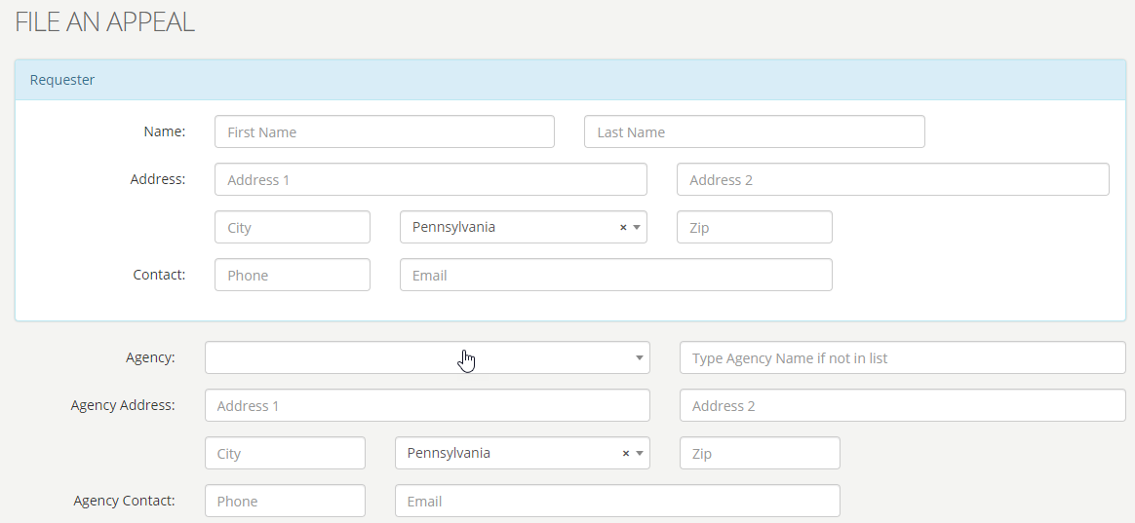
OOR – Online Appeal Form

Slide 52
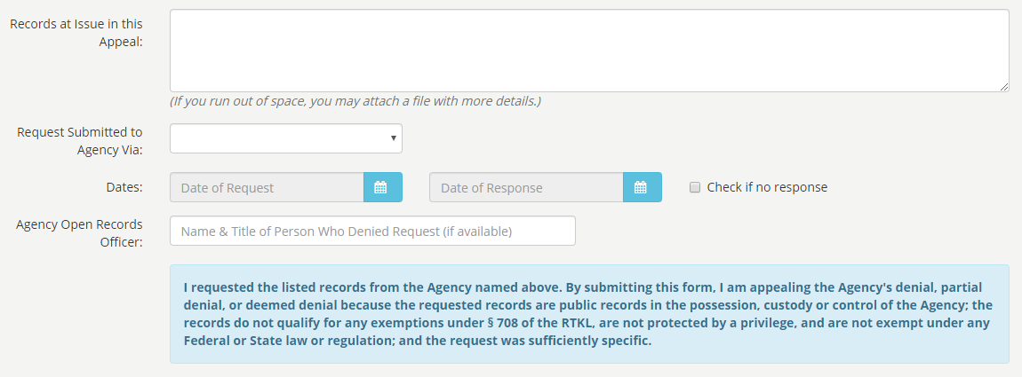
OOR – Online Appeal Form

Slide 53
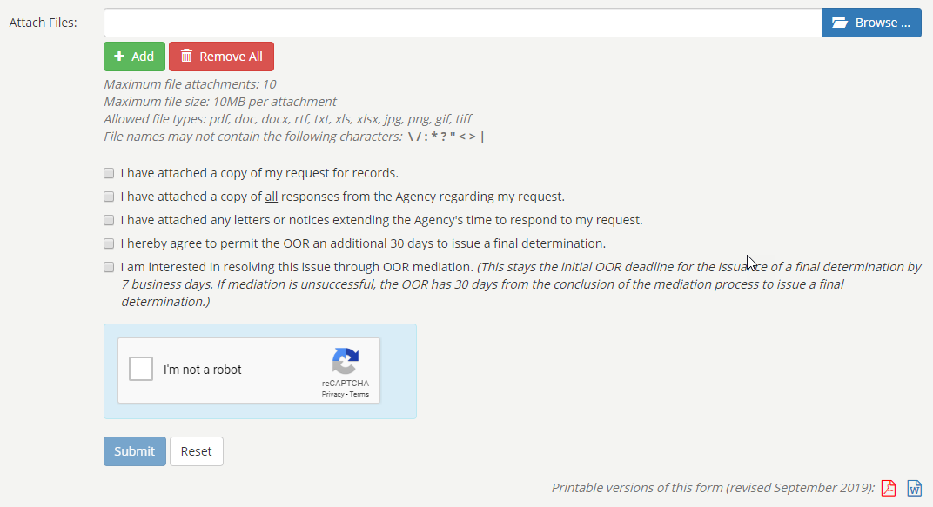
OOR – Online Appeal Form

Slide 54
OOR – Online Appeal Form

Slide 55
Tip: Consider Requesting Mediation
RTKL authorizes OOR to establish informal mediation program
Goal: Mutually agreeable settlement
Voluntary & confidential
Either side can end mediation at any time
If mediation ends, case moves to normal appeal process (new AO)
OOR has trained mediators
Can save time & expense

Slide 56
Office of Open Records
Created by RTKL: Independent & quasi-judicial
Decide appeals filed by people denied access to records
Provide RTKL & Sunshine Act training
20 total staff
Executive Director & Deputy Director
13 Attorneys (incl. 11 Appeals Officers)
Chief of Training & Outreach
4 Administrative

Slide 57
OOR Caseload
Thousands of RTK appeals filed every year
In 2019 (annual report), OOR heard 2,658 appeals
Three-year average: 2,440; Five-year average: 2,470
That’s appeals, not requests
No central database of # of requests
LBFC Study (released 2018) estimated 109,000 requests received by state & local agencies, combined, in 2016
Thus, approximately 2.1% of requests are appealed to OOR
Our data indicates <10% of OOR decisions are appealed to court

Slide 58
OOR Resources
Website, Twitter, Email Lists & More
Website: https://openrecords.pa.gov/
New RTKL Case Law Index
Open Records in PA blog
Email lists: Daily Digest of FDs & General Updates
Twitter: @OpenRecordsPA
Executive Director: @ErikOpenRecords
YouTube Channel
Open Records in PA Podcast: Apple Podcasts, Stitcher, etc.

