Slide 1

The Office of Open Records webinar will begin soon
Use the “Conversation” box to submit questions
Submitted questions are records under the RTKL
After the webinar ends:
  Email openrecords@pa.gov or call 717-346-9903
OOR website has resources for agencies & requesters
  https://www.openrecords.pa.gov/

Slide 2

Office of Open Records
Records Management
and
Electronic Records Best Practices
Tyler Stump Records Services Division
717-783-9874 tystump@pa.gov

Slide 3

Records Management – What is it for?
Ensure that Information is Available from Creation to Disposition to Enable the Process of Governance, and
Protect the Interests of Government and the People it Serves,
At the Lowest Possible Cost

Slide 4
Records Management- What does it mean for me?
1. Ensure that information is available to support office functions/county business
2. Reduce the cost of doing business
3. Keep records as long as needed then dispose

Slide 5
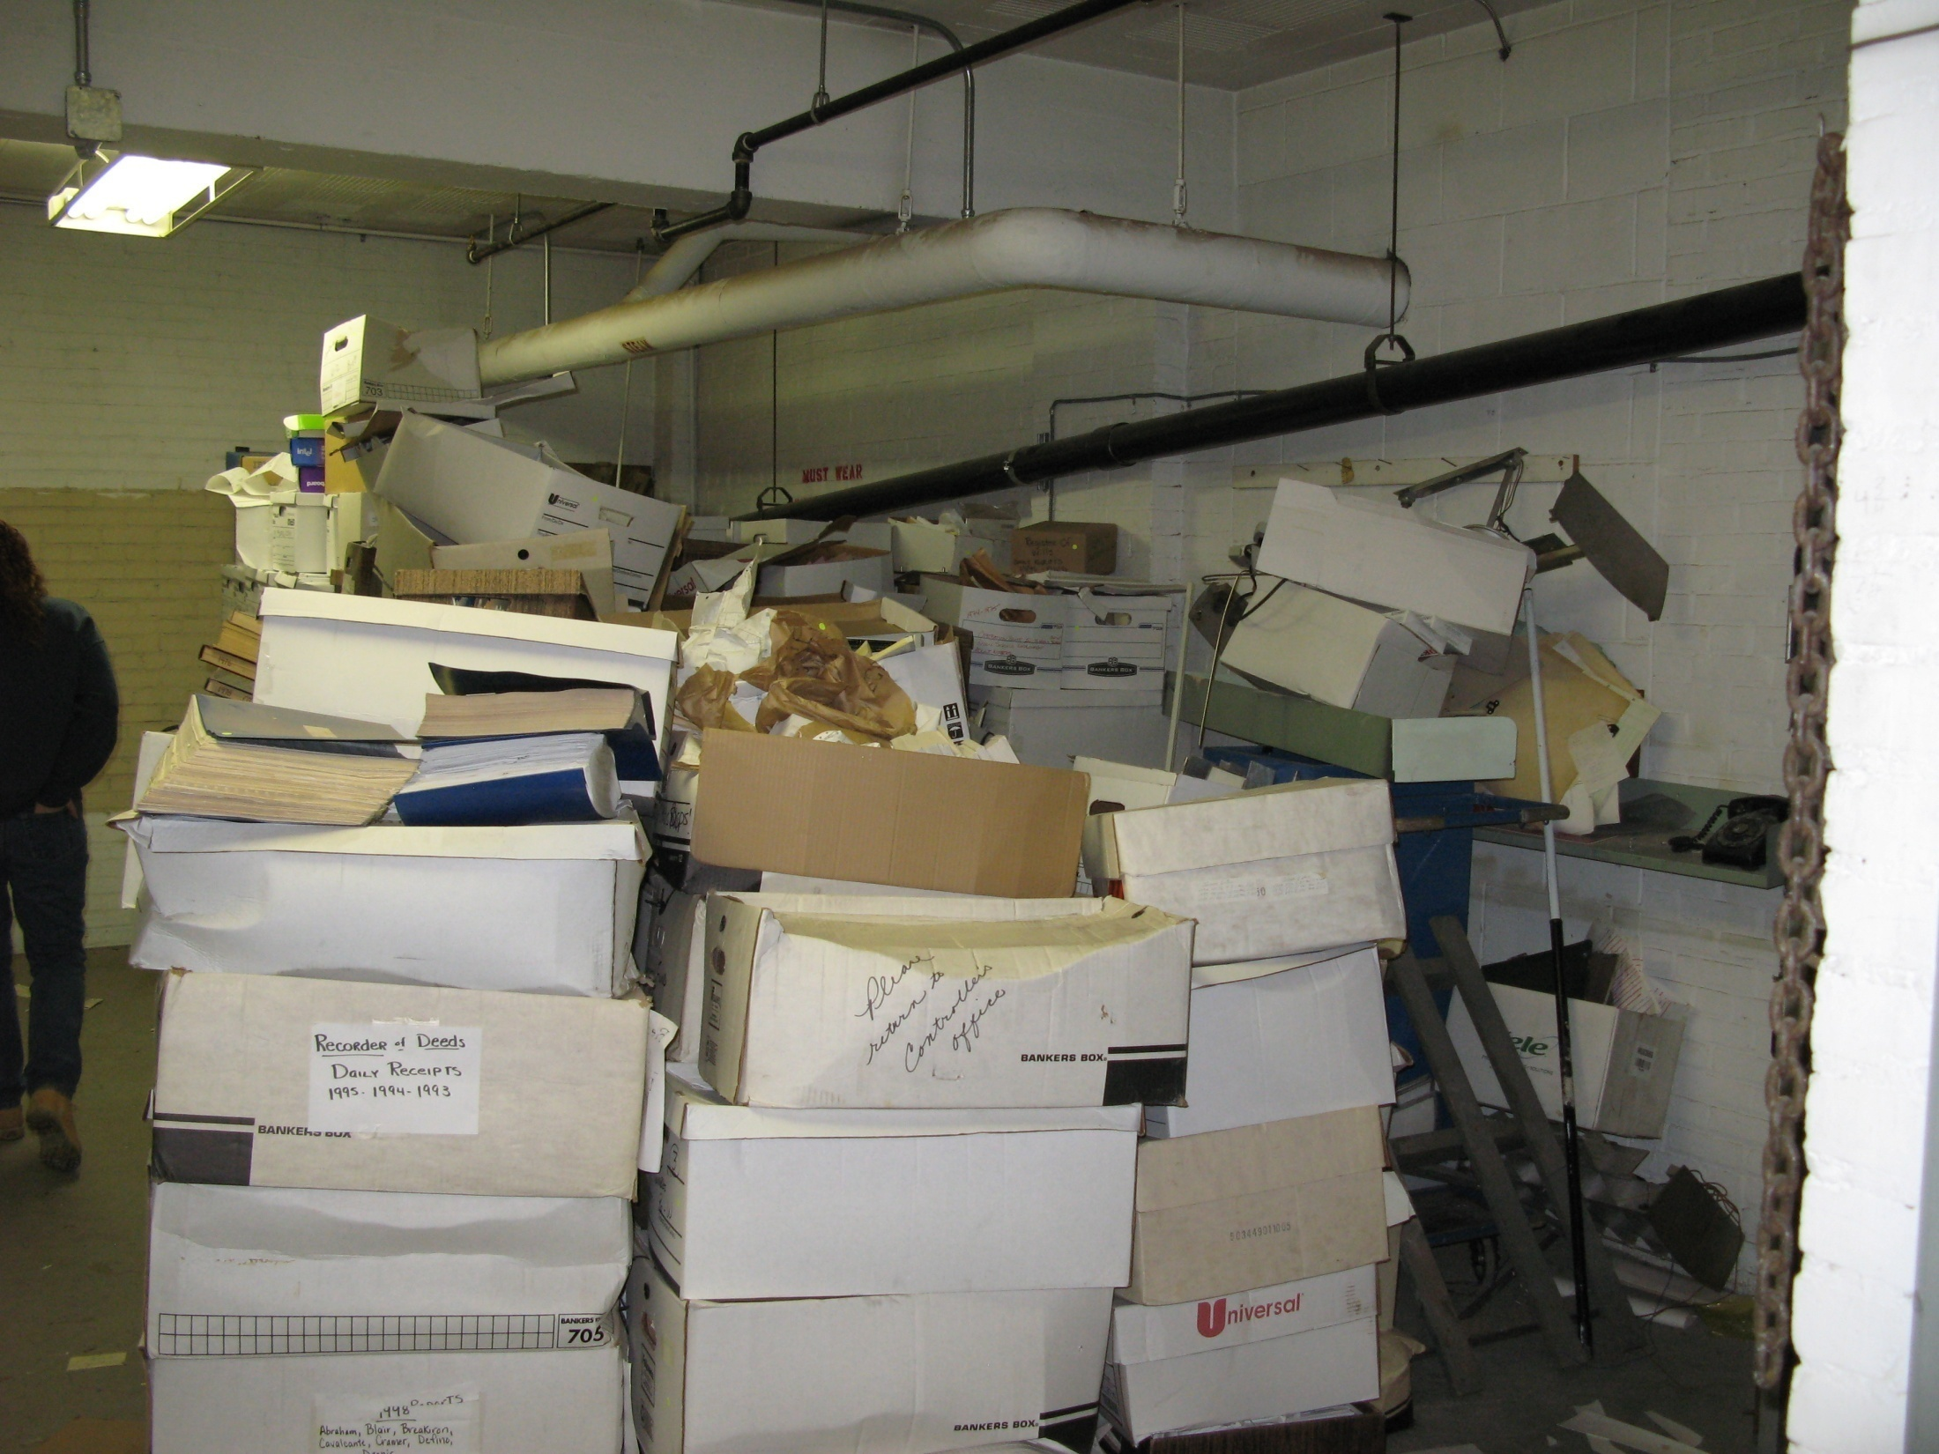
Notes:
County basement full of boxes
This is what we’re trying to eliminate and prevent- too much material and difficulty finding needed records.

Slide 6
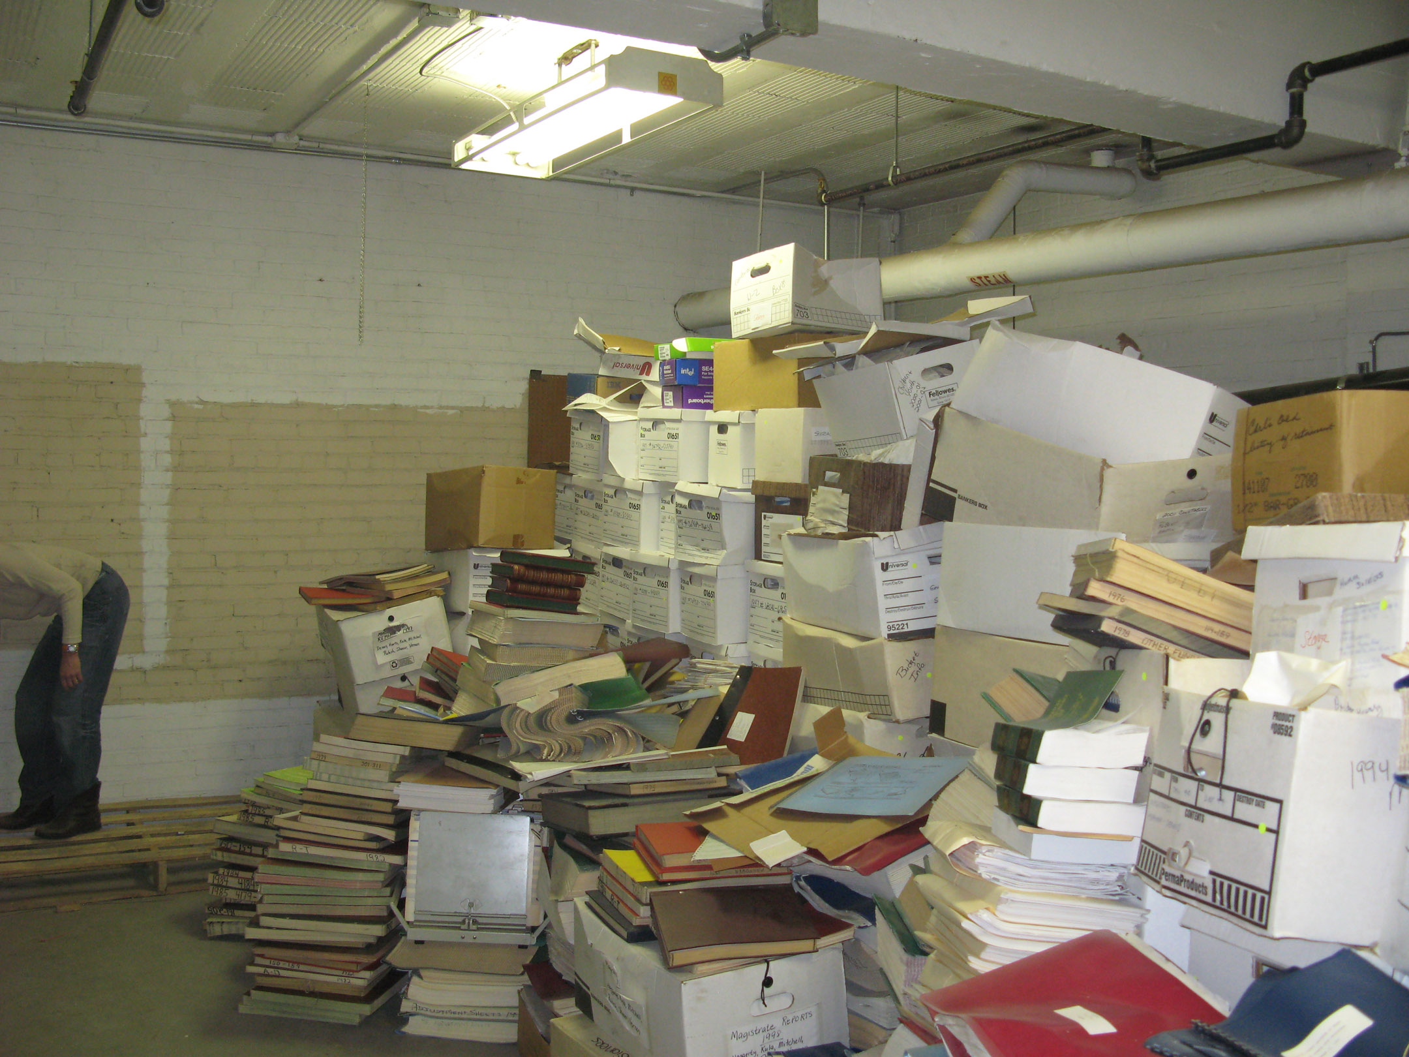
Notes:
Long Side (same pile)
Separating wheat from chaff

Slide 7
First Rule of Records Management
Keep records only as long as necessary and then get rid of them
  The longer records are kept, the greater cost and liability they pose to the agency
Notes:
Records management is often an overlooked yet significant expense, especially in terms of storage space and staff time required.

Slide 8
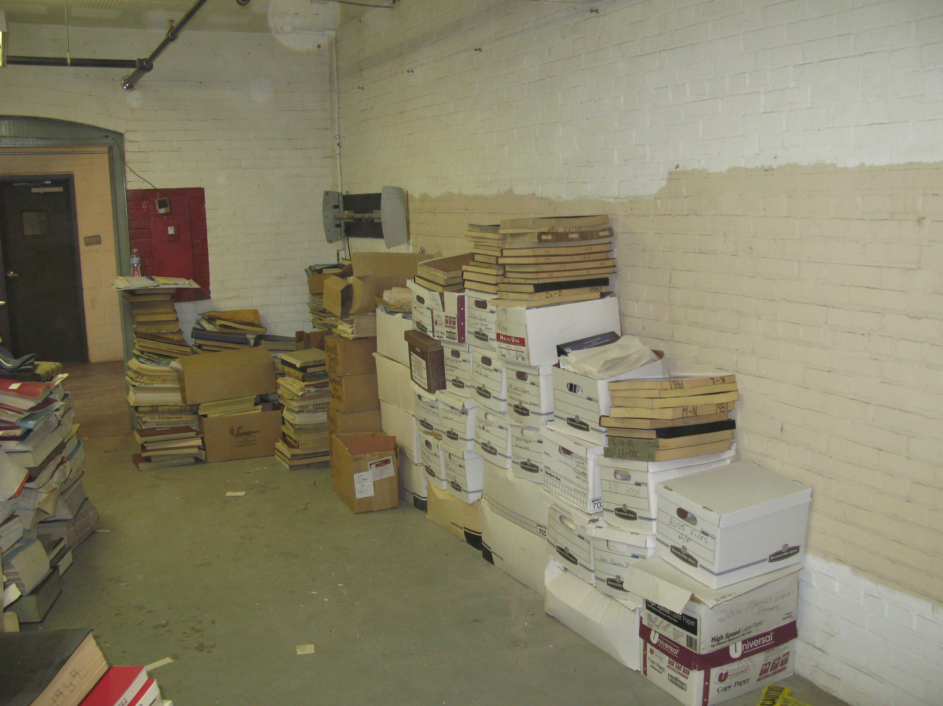
Notes:
What was left
Typical RM: Space and cost savings of 1/3

Slide 9

What is a Record?
Notes:
Vital vs. Essential
??Ask people in office—MY records?
??Personal items grab @ home?
- insurance policies, birth certs, photos, home
videos, PCs, laptops, external hd

Slide 10
What is a Record?
“Any papers, books, maps, photographs or other documentary materials, regardless of physical form or characteristics, made or received by an entity under law or in connection with the exercise of its powers and the discharge of its duties.” (Municipal Records Act)
“Information, regardless of physical form or characteristic, that documents a transaction or activity or an agency and that is created, received or retained pursuant to law or in connection with a transaction, business or activity of the agency.” (Right to Know Law)
Notes:
The General Schedule defines a record as “information, regardless of physical form of characteristic, that documents a transaction or activity or an agency and that is created, received or retained pursuant to law or in connection with a transaction, business or activity of the agency.”

Slide 11
Non-Records but Still Subject to RTK
Published material used for reference
Extra copies of documents used for reference
Drafts
Work copies
Notes
Blank forms
Personal records (non-work related)

Slide 12
Record Types
Transitory Records
  Little/no documentary value. Should be kept until the project/task is completed
Short-Term Records
  Retained for less than 5 years. Usually related to current business and contracts.
Long-Term Records
  Retained for 10+ years but not permanently. Usually related to personnel, long-term contracts or projects, special investigations, etc.
Permanent (Archival) Records
  Has enduring historical, administrative, fiscal, or legal value and should be retained permanently.
Notes:
In general, you want to keep the longer term records more secure and the shorter term records more accessible

Slide 13
Municipal Records Manual
Where is the manual?
  Available on the State Archives website: www.phmc.pa.gov/archives/records-management
Authority?
  Authorized by the Municipal Records Act of 1968, manual maintained by the Pennsylvania Local Government Records Committee
What is this useful for?
  Retention and disposal rules for all official municipal records
  Authorization to keep records in electronic format
  Non-admissibility of officials following the manual

Slide 14
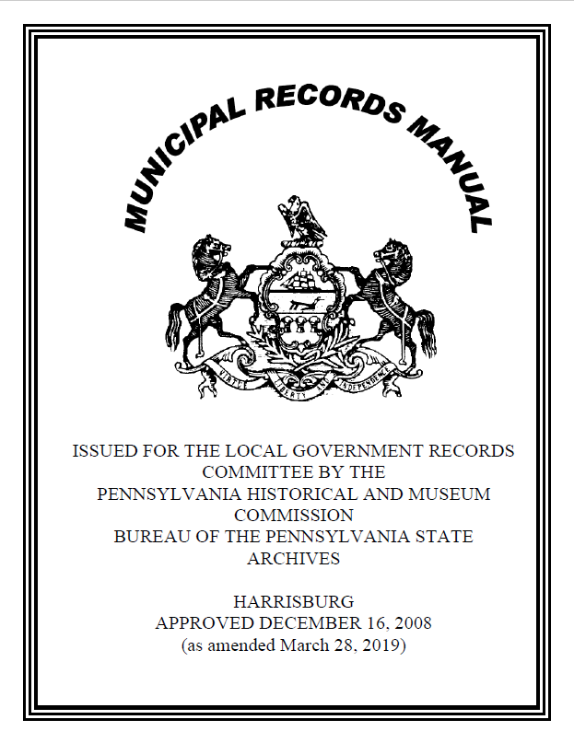
Notes:
The manual applies to County Commissioners, County Clerks, County Executives, Controllers, County Councils, Prothonotaries, and related administrative officers and authorities. This means county prison administrators, clerks, and other officials in county prisons who create and maintain records.

Slide 15
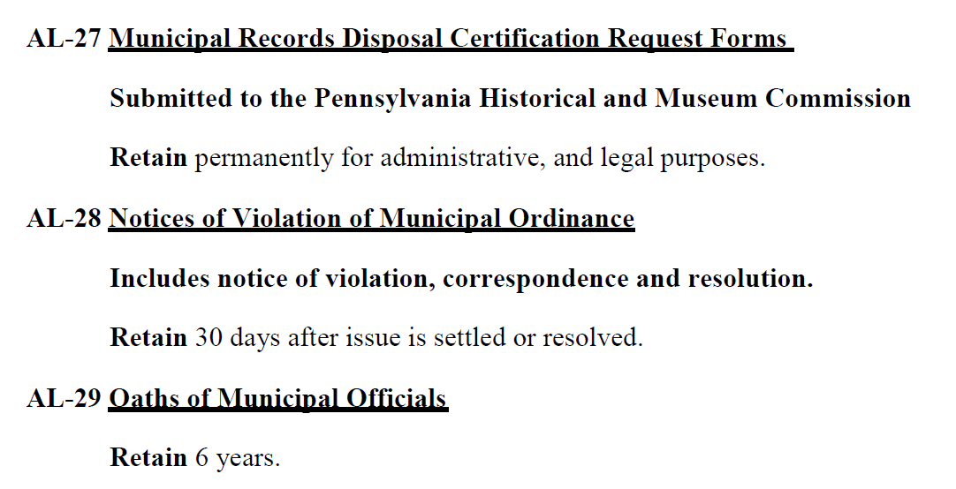
Municipal Records Manual
Record Number
2. Title
3. Description
4. Retention
Notes:
Each entry has 4 parts: a record number, title, description, and retention. Briefly describe what each is and how they work.

Slide 16
Records Disposal
Non-permanent records may be disposed of if…
Permanent records may be disposed of if…
Non-liability of officers

Slide 17
Records Disposal
Municipality must approve each individual act of disposition
Resolution of governing body

Slide 18
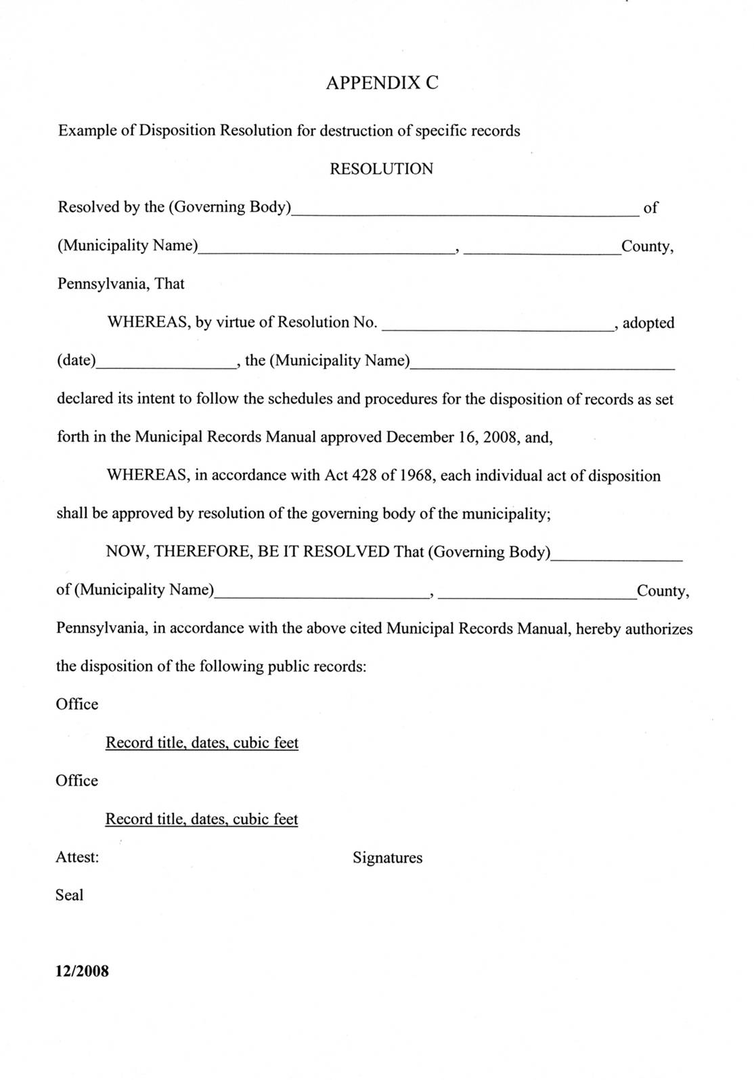
Sample Disposal Resolution

Slide 19
Non-Liability of Records Officers
Section 1387 of Municipal Records Act: Nonliability of official
An official shall not be held liable on his official bond for damages for loss or in any other manner, civil or criminal, because of the disposition of public records pursuant to the provisions of this subchapter.
Section 507 of Right to Know Law: Retention of records
Nothing in this act shall be construed to modify, rescind or supersede any record retention policy or disposition schedule of an agency established pursuant to law, regulation, policy or other directive.

Slide 20
Electronic Records

Slide 21
Electronic Records
Same definition of “records” applies here
All records regardless of format must be retrievable and accessible for the entire length of their retention period
Email that meets the definition of a record is subject to the same rules as a record in any other format

Slide 22

Risks to Electronic Records
Material instability
Improper storage environment (temperature, humidity, light, dust)
Overuse (physical contact media)
Natural disaster (fire, flood, earthquake)
Infrastructure failure (plumbing, electrical, climate control)
Inadequate hardware maintenance
Hardware malfunction
Human error (including improper handling)
Sabotage (theft, malware)

Slide 23
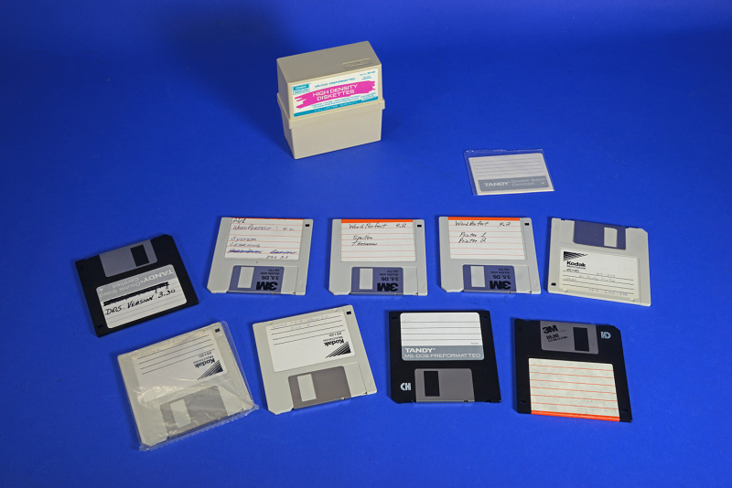
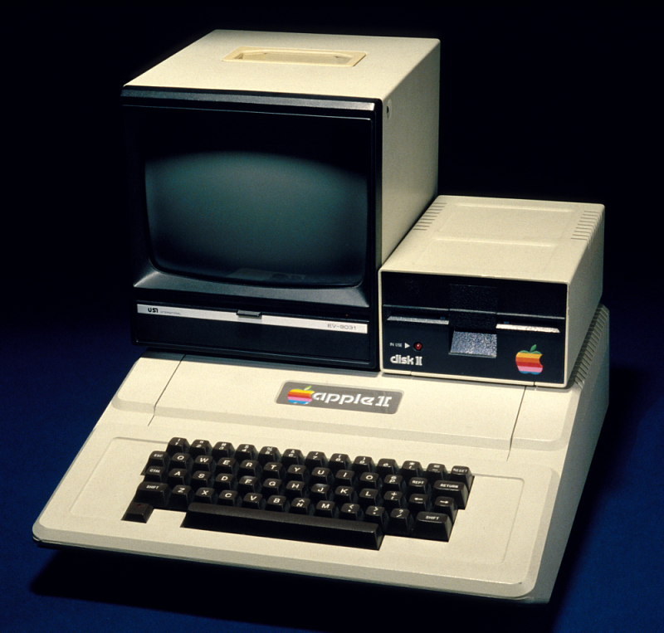
Migrating/Backing Up Files
It’s much easier to restore a backed up file than to recreate a file from scratch
Be consistent with backups
Keep backups physically separate from other copies
Migrate before hardware/software is hard to maintain or replace
Make sure no information is lost or altered during migration

Slide 24
Permanent Electronic Records
“The PDF/A Policy”
In order to keep permanent records in electronic form, municipal offices must:
-Use PDF/A
-Keep at least three copies of records
-Store records in a live server environment
-Notify PHMC
-Agree to follow policy

Slide 25
Protecting Our Records While We Telework

Slide 26

Disclaimer!
Follow your municipality’s internal policies and procedures
on teleworking.
Teleworking procedures must comply with records laws and regulations.

Slide 27

Records Made at Home are Still Public Records
Still subject to Right to Know Law
Stored on personal and work devices

Slide 28
Keep Government Records Separate
Keep electronic records on government issued computers/devices
Try to keep work electronically as much as possible
Keep paper documents physically separate from personal records
Return paper records to work office as soon as practicable

Slide 29
Email and Messaging
Use work accounts for any official business matters
Avoid using personal email, social media, or non-work online platforms
If necessary, transfer records off these systems quickly

Slide 30
Right to Know
All records still subject to requests
Includes public documents on personal devices
Make public records available online if possible

Slide 31
Records Security at Home
Unauthorized people (including family) should not have access to records
Good passwords on all devices with records
Avoid handling records with Personally Identifiable Information at home
Avoid public Wi-Fi
Be weary of viruses and malware
Shred records (do not put public records in recycling)

Slide 32
www.phmc.pa.gov/archives
Tyler Stump 717-783-9874 tystump@pa.gov
Notes:
Thanks again for having me, I’d be happy to take any questions if we have time
Feel free to call or email me if there’s anything I can do in the future!

